Slide 1

Capnography
- the future
Dr David Whitaker
FRCA, FFPMRCA, FFICM, FCARCSI (Hon)

Slide 2
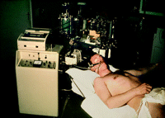
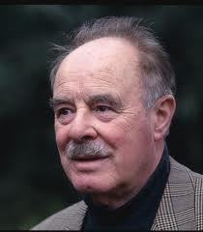
Capnography – the past
The first CO₂ analyzer (Godart Capnograph medical CO₂ analyzer) in the Central Military Hospital, Utrecht, The Netherlands (1962). On top is the one channel Omniascriptor.
Prof. Bob Smalhout

Slide 3
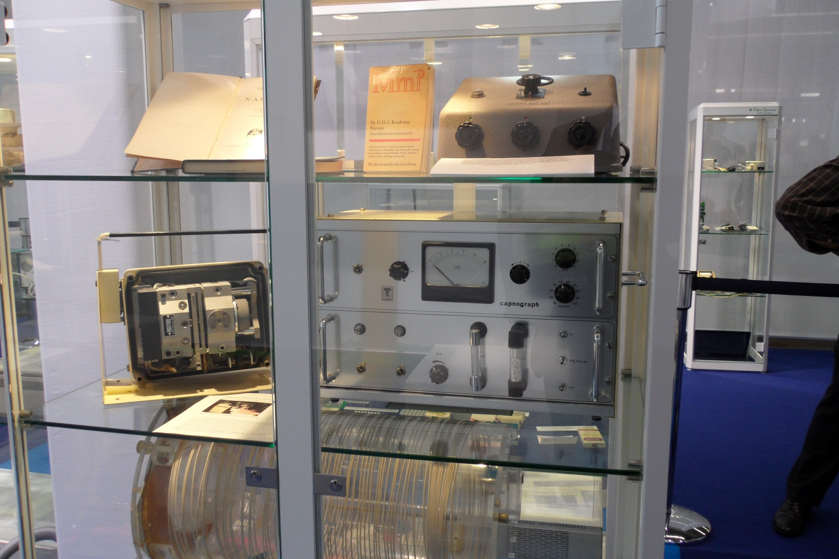
Capnography – the past

Slide 4
Recommendations for Capnography
 |  |  | Theatre |  | ICU |  | Recovery |  | Sedation |  | CPR | Em Dept | Wards
NAP4 |  |  | 2011 |  | 2011 |  | 2011 |  |  |  |  | 2011
ASA |  |  | 1987 |  |  |  |  |  | 2011
AAGBI |  |  | 1988 |  | 2009 |  | 2009 |  | 2009 |  | 2009 | 2009
EBA |  |  | 2008 |  | 2011 |  | 2011 |  | 2011 |  | 2011 | 2011
WFSA |  |  | 2000 |  | 2011 |  | 2011 |  | 2011 |  | 2011 | 2011
Resusc Council |  |  |  |  |  |  |  |  |  |  | 2010
ICS |  |  |  |  | 2011
APSF |  |  |  |  |  |  |  |  |  |  |  |  | 2011

Slide 5
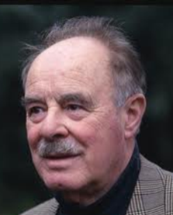


Capnography in Theatre
Original minimal monitoring criteria Prof Bob Smalhout, 1967
Harvard Minimal monitoring John Eichhorn, 1987
AAGBI Minimal monitoring standards Prof Tony Adams , AAGBI Safety 1988
Now near 100% UK evidence from NCEPOD

Slide 6
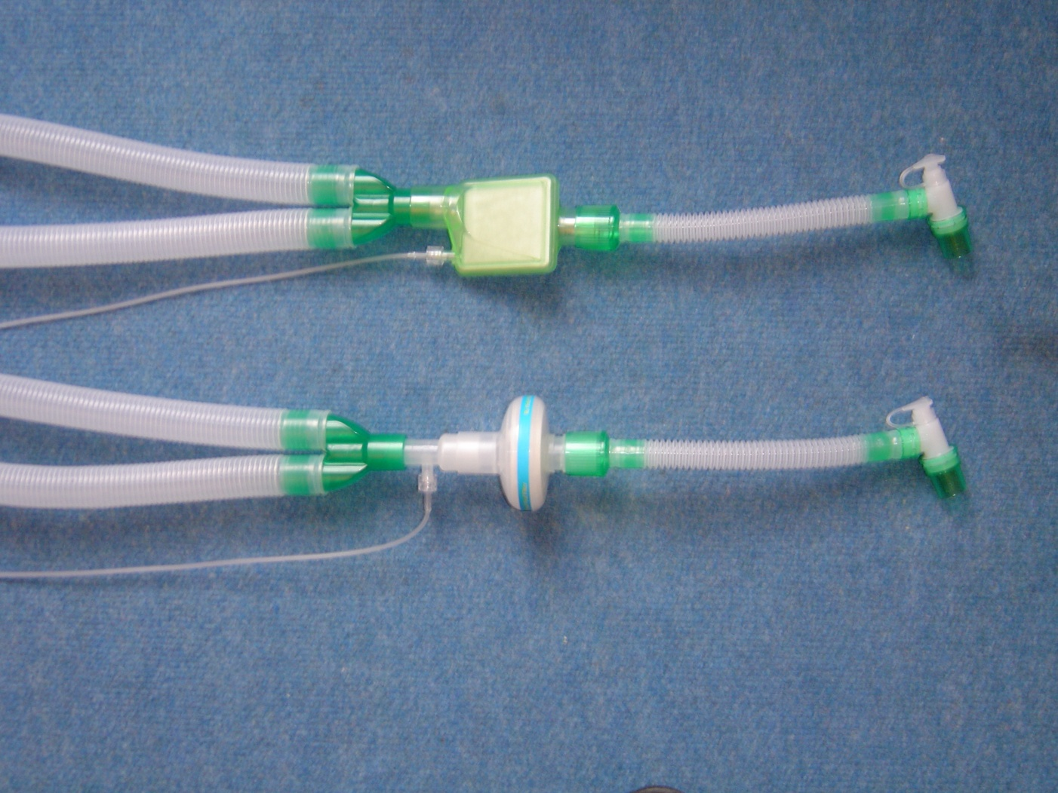
Capnography in Theatre
1980s Capnography monitoring was introduced and sampled direct from circuit via T-piece port
1990s breathing filters introduced to humidify and prevent machines getting infected

Slide 7

Capnography in Theatre
Pall introduced monitoring port on filters
1994 After several patients on a list in Australia got Hepatitis C, Patient Breathing Filters became patient single use
Ragg M. Transmission of Hepatitis C via anaesthetic tubing? Lancet 1994; 44: 367–73

Slide 8
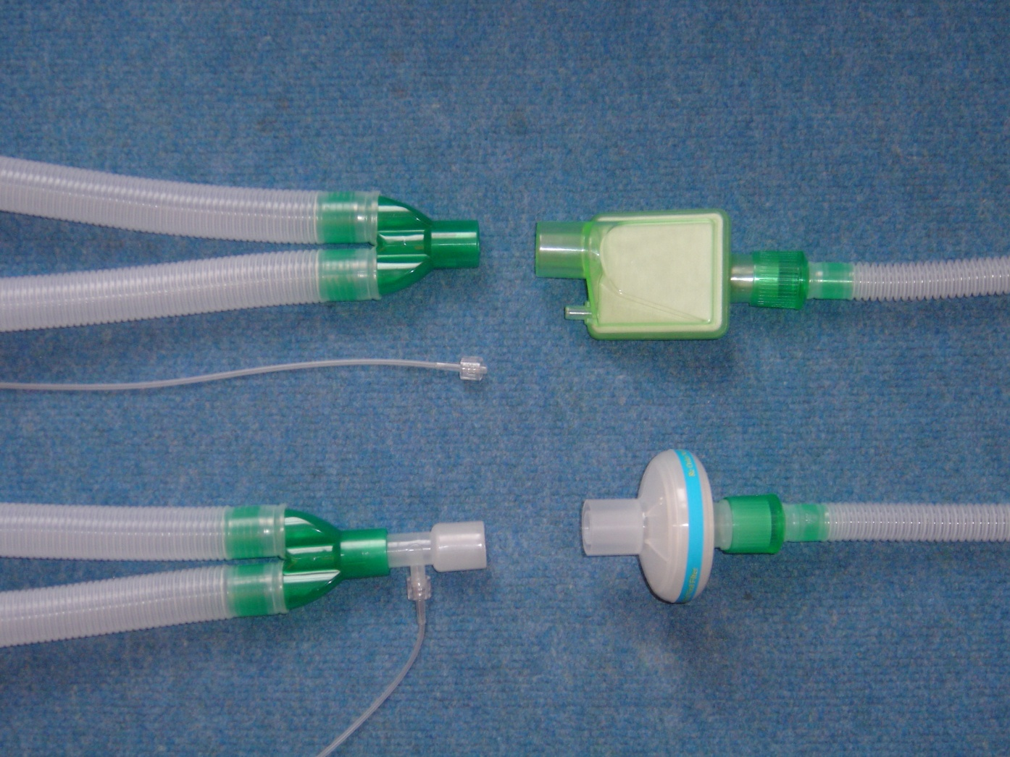
Capnography in Theatre
Filter port presents a cause of unnecessary connection / reconnection, leaks and tube blockage (EGBAT)
2 connections
1 connection
Gulati MS. Less caps, less connecting and instant monitoring. Anaesthesia, 2004, 59, 719–729
×
√

Slide 9
Capnography in Intensive Care
Already heard Tim’s ICU presentation
Continuous capnography for all patients with tracheal tubes (including tracheostomy)
Circuits
  Dry - side stream capnography
  Wet - main stream capnography
    New Cochrane study may say no difference in circuits
Ventilators e.g. new Hamilton Intellivent
Better technology e.g. Microstream

Slide 10
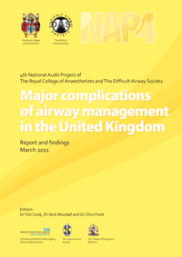
Capnography in Recovery (PACU)
“Capnography has the potential to aid early detection of airway obstruction. It should be available and used in high risk cases.”
NAP4 Recommendation

Slide 11

Capnography in Recovery (PACU)
2011 AAGBI REVIEW final draft
Monitoring, Equipment and Drugs
Clinical observation should be supplemented as in the operating theatre by a minimum of pulse oximetry, non-invasive blood pressure monitoring, ECG and, if patients’ tracheas remain intubated or a supraglottic or other similar airway device is in place, continuous capnography

Slide 12
Capnography in Recovery (PACU)
Transfer and Handover of Care to the PACU Team
If the PACU is not immediately adjacent to the operating theatre, or if the patient’s condition is poor, mobile monitoring is required, i.e. a minimum of pulse oximetry and non-invasive blood pressure, ECG and capnography if the trachea is intubated or if a supraglottic airway is in place.

Slide 13

Capnography in Recovery (PACU)
Tracheal Tubes and Other Airway Devices
The incidence of upper airway obstruction, which can lead to pulmonary oedema and severe hypoxia can be decreased by the use of oropharyngeal airways, bite blocks, airway devices incorporating them or similar devices .
Ref =
As noted above, all patients with tracheal tubes or supraglottic airways in place in PACU should be monitored with continuous capnography.

Slide 14
Capnography in Recovery (PACU)
Monitoring, Equipment and Drugs
An appropriate standard of monitoring should be maintained until the patient is fully recovered from anaesthesia. Clinical observation should therefore be supplemented as in the operating theatre by a minimum of pulse oximetry, non-invasive blood pressure monitoring, ECG and, if patients’ tracheas remain intubated or a supraglottic or other similar airway device is in place, continuous capnography

Slide 15
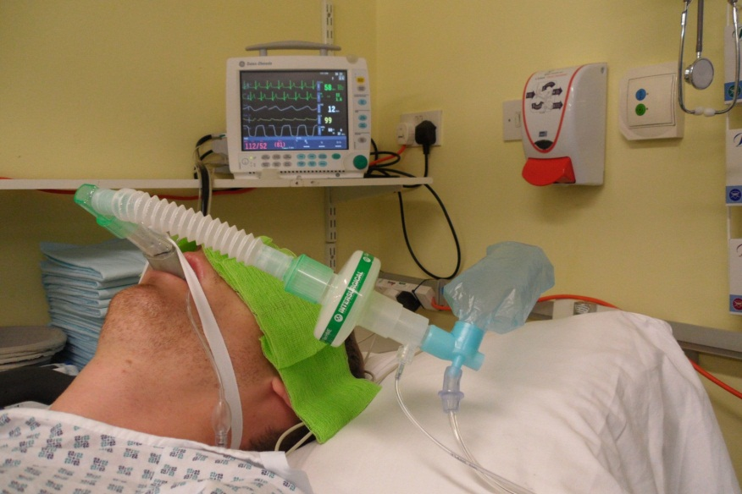
Capnography in Recovery (PACU)
Key Recommendation 8
All patients with tracheal tubes or supraglottic airways in place in PACU should be monitored with continuous capnography

Slide 16

Capnography in Recovery (PACU)

Slide 17
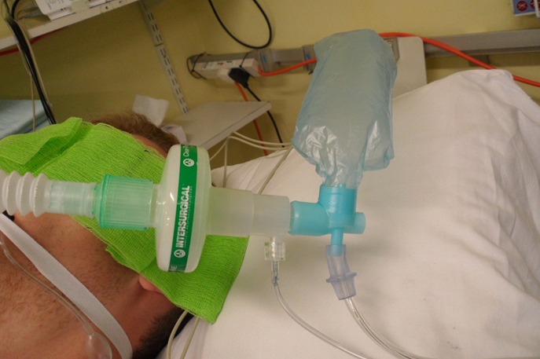
Capnography in Recovery (PACU)
By retaining the patient’s own catheter mount and breathing filter the capnography connection can be reused for many patients (as in theatre)

Slide 18
Capnography in Recovery (PACU)
6 patients per recovery bay per day
30 patients per recovery bay per week
Disposable (£6) changed every week
So disposable costs 20 pence per patient
10,500 patients per recovery bay per 7 years
Capnography module costs £1000
So capnography equipment costs 10 pence per patient
Total cost of capnography is 30 pence per patient

Slide 19
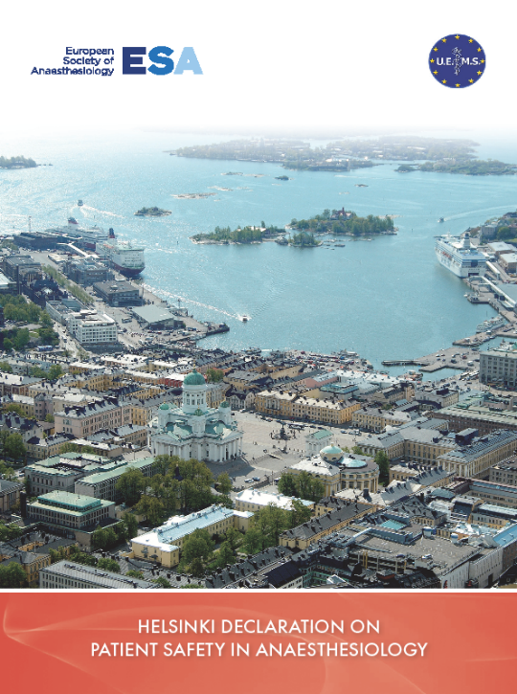
Capnography in Recovery (PACU)
2010 Helsinki Declaration on Patient Safety in Anaesthesiology
Survey of it’s implementation
in the Berlin-Brandenburg
area of Germany showed
62% had capnography in
Recovery (28 hospitals)
Patient safety in anaesthesia: assessment of status quo in the Berlin-Brandenburg area, Germany. Balzer F et al. EJA 2011, Vol 28 No 10. 749-52

Slide 20
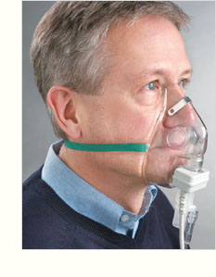
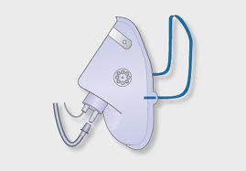
Capnography in Sedation
Sedation is a major practice growth area as new procedures are developed
Gastroenterology
Emergency Departments
Ophthalmology
Dental
Cardiology
Radiology

Slide 21
Capnography in Sedation
Pulse oximetry has recently been the safety monitor
Numerous articles and studies show capnography catches what oximetry can not show or show too late
Abnormal ETCO₂ findings were observed with many acute respiratory events.
A majority of patients with acute respiratory events had ETCO₂ abnormalities that occurred before oxygen desaturation or observed hypoventilation.
Acad Emer Med, 2006 MayBurton JH, Harrah JD, Germann CA, Dillion DC. Department of Emergency Medicine, Maine Medical Center, Portland, ME, US

Slide 22
Capnography in Sedation
ASA have recommended capnography for all moderate and deep sedation
AAGBI the same
European Board of Anaesthesiology the same
Absolute FE CO2 values not important
Breathing pattern and respiratory rate are important safety assessments particularly in darkened x-ray or catheter laboratories

Slide 23
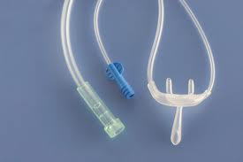
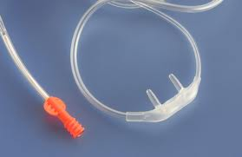
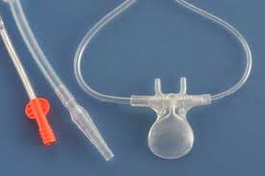
Capnography in Sedation
Spontaneously breathing patients alternate between nasal and mouth breathing
Various devices are available but they need to take account of this to avoid false alarms
Don’t forget bacterial filter

Slide 24
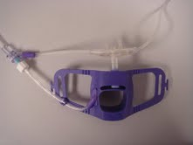
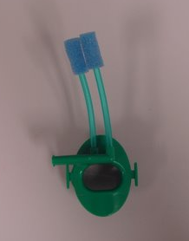
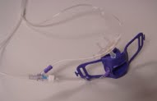
Capnography in Gastroscopy

Slide 25
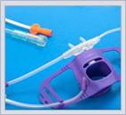
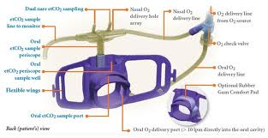
Capnography in Gastroscopy
The Capnobloc

Slide 26
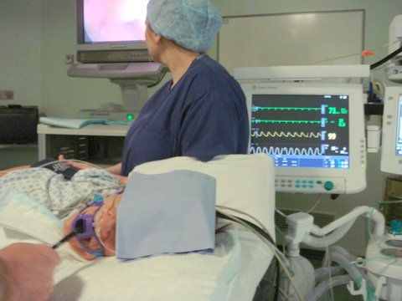
Capnography in Gastroscopy

Slide 27

Capnography in Resuscitation
Increased emphasis is on the use of capnography to confirm and continually monitor tracheal tube placement, quality of CPR and to provide an early indication of return of spontaneous circulation (ROSC)
Deakin CD, Nolan JP, Soar J, et al. Section 4. Adult advanced life support. Resuscitation 2010; 81:1305–1352.

Slide 28
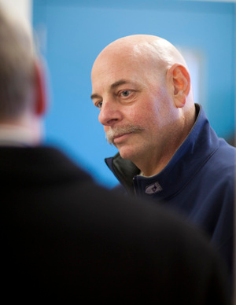
Capnography in Resuscitation
Howard Snitzer's heart stopped beating for 96 mins in January 2011. First responders didn't give up on him, thanks in part to capnography, a technology that let them know Snitzer still had a chance of coming back.
This information helps determine whether a patient is hyperventilating or having a heart attack. It helps to decide how to treat an asthma attack, or determine whether CPR is working.

Slide 29
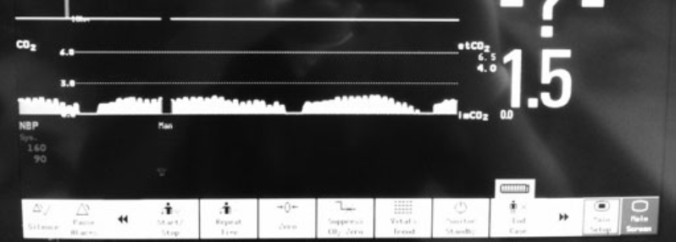
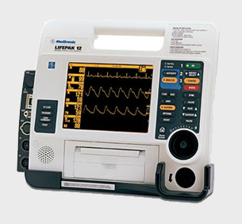
Capnography in Resuscitation
Always some CO2 if massaging less than 30mins
Do not assume that failure to detect CO2 is because of cardiac arrest
Most manufacturers make
defibrillators with capnography

Slide 30
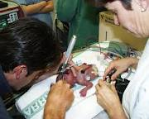
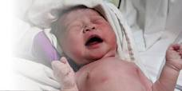
Capnography in Neonatal Resuscitation
Confirms tube placement in very low birth wt
In attempted intubations of 40 neonates it correctly identified 40 tracheal and 11 oesophageal
Salthe J et al, Capnography rapidly confirmed correct endotracheal tube placement during resuscitation of extremely low birthweight babies (< 1000 g). Acta Anaesthesiologica Scandinavica 2006; 50: 1033–6.

Slide 31
Capnography on the Post op Wards
In US study monitoring patients with PCA, respiratory depression has been found to be higher than previously reported
Anaesthesia Patient Safety Foundation (APSF) has recently said “No Patient shall be harmed by Opioid induced respiratory depression”
Recommends Capnography as best monitor to do this
Capnography is best resp rate monitor available

Slide 32
Capnography in Emergency Dept
Anaesthesia ICU Emergency Dept
Death 16 18 4
Death + Brain Damage 18 22 1
Denominator 2.9m* 48,000** 20,000***
Incidence Death 1:180,000 1:2,700 1:5,000
Relative Death Rate 1 x 67 x 36
RR (Death + Brain Damage) 1 x 70 x 38
*NAP4 Census
**HES ICU data 2008/9
*** Hopkinson/Benger EMJ 2010

Slide 33

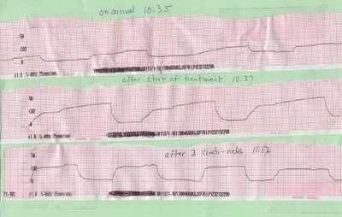
Capnography in Emergency Department
Essential safety monitor for airway
Available for resuscitation and CPR
Possible use in acute exacerbations of respiratory disease
Analysis of waveform
is effort independent
and continuous
compared to peak flow

Slide 34
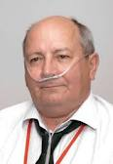

Capnography in Respiratory Medicine
British Thoracic Society Guidelines for Emergency Oxygen Therapy recommends respiratory rate as single best predictor of severe illness in a breathless patient.
Capnography is best way to measure and record and monitor this

Slide 35
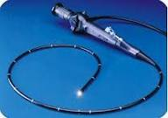
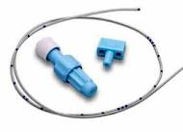
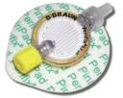
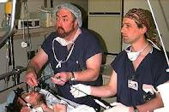
Capnography in Fibreoptic intubation

Slide 36

Capnography in US Courts
When a Paramedic was questioned, the discussion turned to capnography
...I assure you it has nothing to do with
"cat pornography"

Slide 37

Capnography - the future
Use in theatre using breathing filters without ports
Continuous capnography on every intubated patient in ICU including tracheostomies
All Recovery bays equipped with capnography and it used on intubated/ LMA patients
All patients having sedation
Selected post op patients on Wards
Use at every resuscitation and all modern Defibrillators to include it
Use at neonatal resuscitations
Use at fibreoptic intubations

Slide 38
Capnography
- the future
You know it makes sense
Time for capnography – everywhere. D. K. Whitaker
Anaesthesia Volume 66, Issue 7, July 2011, Pages: 544–549
whitaker2000@gmail.com

