Slide 1
Capnography During Sedation
Bhavani Shankar Kodali MD
Associate Professor, Harvard Medical School,
Vice Chair, Clinical Affairs
Brigham and Women’s Hospital

Slide 2
New Standards of Monitoring
American Society of Anesthesiologists (ASA) and the Association of Anaesthestists of Great Britain and Ireland (AAGBI) have revised standards in 2011 to monitor ventilation with capnography for all procedural sedation cases requiring moderate to deep sedation.
Bhavani Shankar Kodali M.D.
www.capnography.com

Slide 3
Why were they introduced?
It is difficult to predict how an individual will respond to an administered sedative.
Incidence of hypoxia is less if capnography was used to monitor ventilation.
Capnography when used in conjunction with pulse oximetry and visual inspection of chest detected respiratory depression 17 times more often than without capnography.
Capnography forewarns of impending hypoxia by about 5 to 240 seconds.
Capnography triggers early intervention and decreases the incidence of oxygen desaturation.
Administration of supplemental oxygen delays the onset of desaturation following apnea and therefore relying on pulse oximetry alone will delay intervention.
Bhavani Shankar Kodali M.D.
www.capnography.com

Slide 4
Objectives
After reviewing this brief clinical concept, the clinician/nurse will understand the basic physiology of capnography.
The clinician/nurse will be able to interpret capnography in monitoring ventilation during sedation more effectively and safely
Bhavani Shankar Kodali M.D.
www.capnography.com

Slide 5
Definitions
PETCO₂: The maximum partial pressure of CO₂ at the end of a breath. It is about 36- 40 mm Hg in healthy adults.
PACO₂: Partial pressure of CO₂ in the alveoli.
Capnogram: A plot of PCO₂ versus time (time capnogram), or expired volume (volume capnogram). Time capnogram is common in clinical practice
Bhavani Shankar Kodali M.D.
www.capnography.com

Slide 6
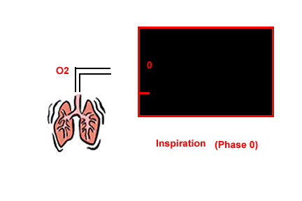
Basic Physiology
When you inhale CO₂ free air and exhale, and measure partial pressure of CO₂ at the mouth, you get the following trace. Normal values of PETCO₂ vary between 35 and 40 mm Hg
Bhavani Shankar Kodali M.D.
www.capnography.com

Slide 7
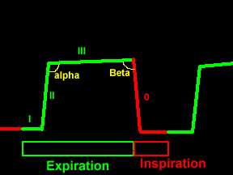
Basic Physiology
The expiratory segment is divided into three phases phase I, II, and III
Phase I: Dead space gases
Phase II: Dead space gases mix with alveolar gases resulting in the rise of PETCO₂
Phase III: Represent CO₂ evolving from alveoli
Bhavani Shankar Kodali M.D.
www.capnography.com

Slide 8
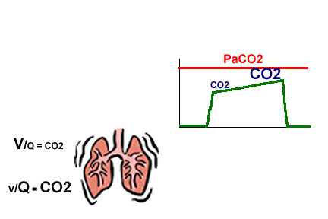
Basic Physiology
The height and slope of the alveolar plateau (phase III ) is dependent on the CO₂ content in the alveoli. The CO₂ content is in turn dependent on the V/Q ratio of the alveoli. High V/Q alveoli contain relatively low PCO₂, while low V/Q alveoli contain relatively high PCO₂
Bhavani Shankar Kodali M.D.
www.capnography.com

Slide 9
Basic Physiology
Hence, it can be concluded that the height and the slope of the alveolar plateau is dependent on ventilation, cardiac output and more importantly on V/Q relationship.
Bhavani Shankar Kodali M.D.
www.capnography.com

Slide 10

Basic Physiology
For example in COPD: the V/Q perfusion abnormalities result in a sloping phase II and phase III
Bhavani Shankar Kodali M.D.
www.capnography.com

Slide 11
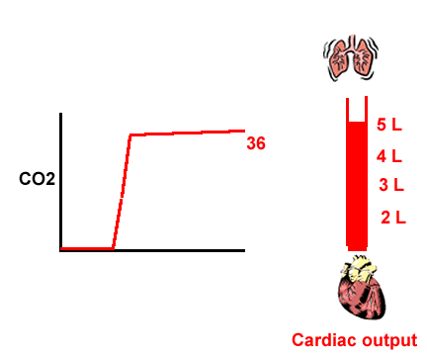
Basic Physiology
In the acute settings, for a given ventilation, PETCO₂ is a function of cardiac output (pulmonary perfusion).
This is the basic principle of directing the uses of capnography during CPR
Bhavani Shankar Kodali M.D.
www.capnography.com

Slide 12

Basic Physiology
Hypoventilation
Hyperventilation
Bhavani Shankar Kodali M.D.
www.capnography.com

Slide 13
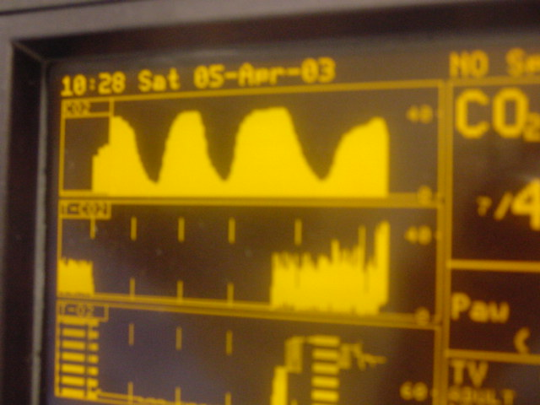
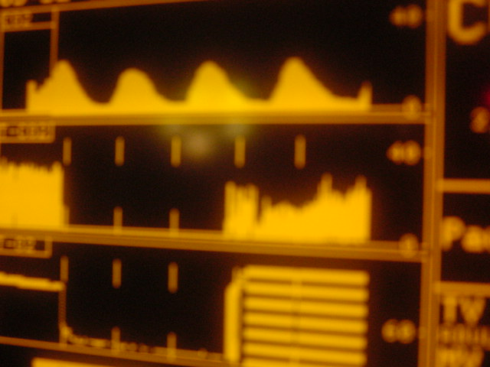
Capnograms during spontaneous ventilation
The shape of the capnograms obtained when oxygen is being administered via face mask can be different due to dilution of expired CO₂ by oxygen or room air as shown below
Bhavani Shankar Kodali M.D.
www.capnography.com

Slide 14
Capnograms during sedation
The important concept here is to determine changes from baseline capnograms
Bhavani Shankar Kodali M.D.
www.capnography.com

Slide 15
Capnograms during spontaneous ventilation
Look for three important changes from baseline capnograms
Respiratory rate: A decreased rate indicates respiratory depression. Increased rate suggests stimulation from the procedure
If the PETCO₂ increases, it suggests hypoventilation
If the PETCO₂ decreases, it suggests hyperventilation, hypoventilation, or upper airway obstruction depending on the cause. Observe the patient carefully for evidence of respiratory obstruction. If present, give jaw thrust, PETCO₂ increases as obstruction is relieved. If there is no improvement in PETCO₂, it most likely suggests a central depression. Hyperventilation is indicated by an increased respiratory rate.
Bhavani Shankar Kodali M.D.
www.capnography.com

Slide 16
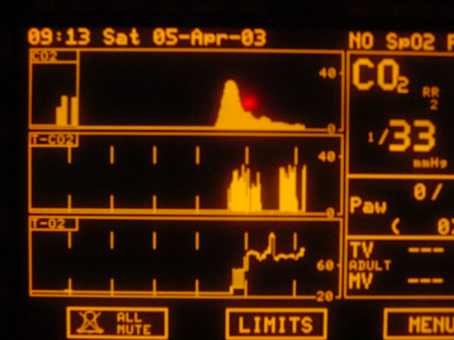
Over sedation
Respiratory rate is decreased
Bhavani Shankar Kodali M.D.
www.capnography.com

Slide 17
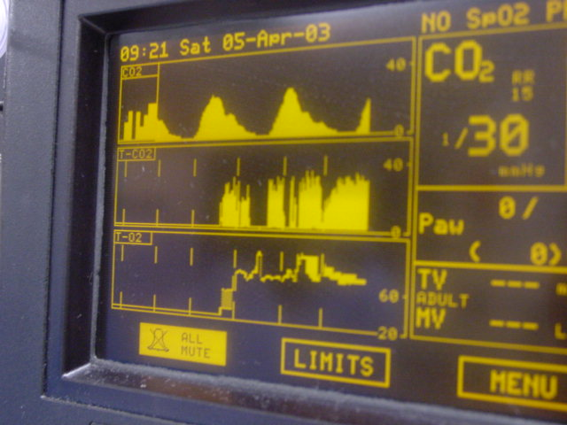
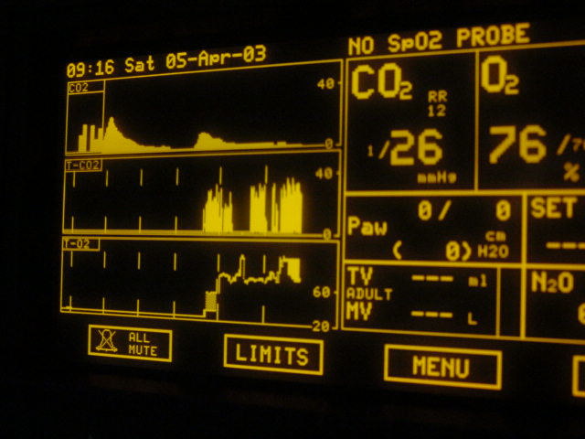
Over sedation
Height of the capnogram PETCO₂ decreased
Bhavani Shankar Kodali M.D.
www.capnography.com

Slide 18
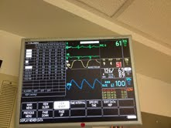
Hypoventilation
Height of the capnogram (PETCO₂) is increased
Bhavani Shankar Kodali M.D.
www.capnography.com

Slide 19
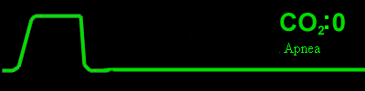
Apnea, or Respiratory obstruction
A flat line indicates that there is apnea, or total respiratory obstruction. It may also indicate disconnection of the CO₂ sampling system, or inability to sample the expired air. These circumstances call for immediate examination of the patient for apnea, or respiratory obstruction, or sampling issues.
Bhavani Shankar Kodali M.D.
www.capnography.com

Slide 20
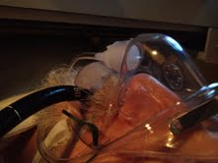
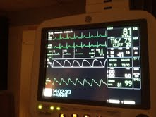
Sampling devices to monitor PETCO₂
Here, PETCO₂ is being sampled with a nasal sampling cannula (arrow), oxygen is being administered via an oxygen mask. An endoscope is inserted via a flap cut in the mask. This ensures adequate oxygenation and sampling of CO₂
Bhavani Shankar Kodali M.D.
www.capnography.com

Slide 21
Some Examples of Devices for CO₂ sampling

Slide 22
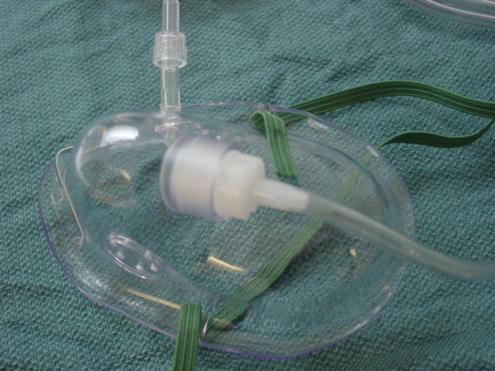
Bhavani Shankar Kodali M.D.
www.capnography.com

Slide 23
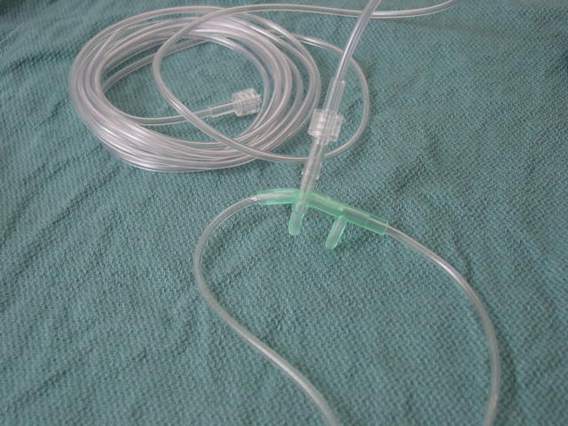
Bhavani Shankar Kodali M.D.
www.capnography.com

Slide 24
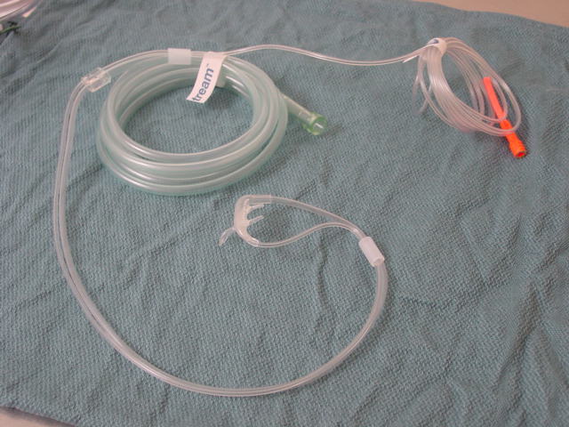
Bhavani Shankar Kodali M.D.
www.capnography.com

Slide 25
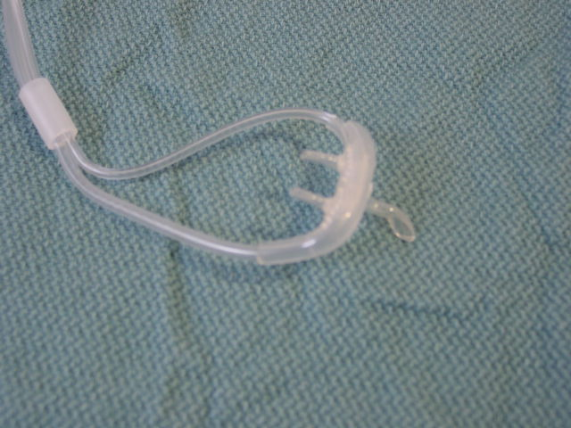
Bhavani Shankar Kodali M.D.
www.capnography.com

Slide 26
Conclusion
Place the sampling device and obtain best PETCO₂ values and waveforms
Look for changes from baseline values and shape of capnograms
Hypoventilation is suggested by decreased respiratory rate, increased PETCO₂ values, or decreased PETCO₂ values (depending on cause).
Hyperventilation is indicated by an increase in respiratory rate
Look for evidence of respiratory obstruction when you begin to see changes in PETCO₂ values, or shape.
Lifting the jaw forwards relieves upper airway obstruction and increased PETCO₂ values
Bhavani Shankar Kodali M.D.
www.capnography.com

Slide 27
Differential Diagnosis of Capnography during Sedation
Apnea
Total Respiratory Obstruction
Sampling Issue
PETCO₂
No CO₂
Decreased
Hypoventilation
Partial Respiratory Obstruction
Hyperventilation
Increased
Hypoventilation
Observe patient to differentiate
Decreased
Respiratory Rate
Increased Respiratory Rate
Hypoventilation
Partial Respiratory Obstruction
Hyperventilation
Jaw Thrust
If relieved, then respiratory obstruction
If not relieved, then hypoventilation
Pulse Oximetry can be used as an adjunct in differential diagnosis .
Capnography should help to diagnose the problem before changes in SPO₂
Bhavani Shankar Kodali M.D.
www.capnography.com

Slide 28
References
Br J Anaesth 2011; 106: 617-31
Acad Emerg Med 2000; 7: 228-35
Acad Emerg Med 2007; 14: 41-6
Am J Gastroenterol 2007; 102: 738-43
Curr Opin Anaesthesiol 2007; 20: 347-51
Ann Emerg Med 2010; 55: 258-64
J Clin Anesth 2011; 23: 189-96
Am J Gastroenterol 2012 May 29. doi: 10.1038/ajg.2012.136. [Anesthesiology 2009; 110: 759-65
Anesthesiology 2006; 104: 228-34
Bhavani Shankar Kodali M.D.
www.capnography.com

Slide 29
Question 1
Normal PETCO₂ values in healthy adults breathing normally with good sampling
(a) 80 mm Hg
(b) 40 mm Hg
(c) 20 mm Hg
(d) 25 mm Hg

Slide 30
(b)

Slide 31
Question 2
During capnography monitoring for sedation, it is important to determine PETCO₂ changes from baseline capnograms
True
False

Slide 32
True

Slide 33
Question 3
If PETCO₂ increases during sedation, it suggests
(a) Hyperventilation
(b) Hypoventilation
(c) Respiratory obstruction
(d) Low cardiac output

Slide 34
(b)

Slide 35
Question 4
If PETCO₂ decreases during sedation, it suggests
(a) Hyperventilation
(b) Respiratory obstruction
(c) Hypoventilation
(d) All of the above

Slide 36
(d)

Slide 37
Question 5
Generally, capnography changes like hypoventilation, or respiratory obstruction occur before oxygen desaturation
True
False
Neither

Slide 38
True

