Slide 1

Advisor Live®
Safe opioid use – Strategies for reducing adverse events and related harm
March 4, 2014
@PremierHA
#AdvisorLive
Download today’s slides at www.premierinc.com/AdvisorLive

Slide 2
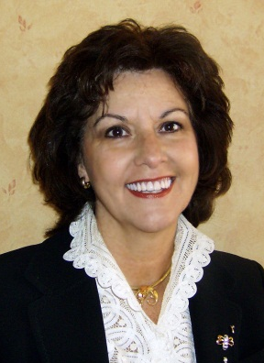




Faculty
Moderator:
Gina Pugliese, RN MS vice president, Premier Safety Institute®
Michael Wong, JD executive director, Physician-Patient Alliance for Health & Safety
Harold J. A. Oglesby, RRT manager, The Center for Pulmonary Health Candler Hospital, Saint Joseph’s/ Candler Health System, Savannah, GA
Joan Speigel, MD assistant professor, Anesthesiology, Harvard Medical School and Beth Israel Deaconess Medical Ctr
Bhavani S. Kodali, MD associate professor, Department of Anesthesiology, Brigham and Women’s Hospital, Harvard Medical School

Slide 3
Harold Julius A. Oglesby, RRT.
Manager, The Center for Pulmonary Health
Candler Hospital
Saint Joseph’s/ Candler Health System
Savannah, Georgia
Our Experience in
Successfully using ETCO2 Monitoring
During the Usage of PCA Pain Management

Slide 4


St. Joseph’s/Candler Health System
Savannah, GA
2 hospital system, tertiary care, community, referral centers
Two of the oldest continuously operating hospitals in the nation
Largest healthcare system in SE Georgia; 675 beds
Approximately 25,000 annual discharges

Slide 5

BALANCING EFFECTIVE ANALGESIA WITH SAFETY

Slide 6
What caused a change in PCA delivery at SJCHS?
We experienced three opioid-related events with serious outcomes in the 2 years preceding our embarking on a multiyear process of implementing an advanced IV medication safety system.

Slide 7
PCA Team Developed
The team recognized that safe use of PCA required both correct pump programming and monitoring of patients’ individual respiratory response to opioids.

Slide 8
1st STEPS in our progression to becoming involved in the monitoring of post-operative patients receiving pain management
The pharmacy and nursing staffs were attempting to address safety concerns with regards to PCA pain medication delivery. Respiratory Care was called in to address monitoring options early on in the decision making process.

Slide 9
Beta Testing
Beta testing revealed the difficulty of predicting which patients actually were high-risk. We did note that capnography, not pulse oximetry, provided the first indication of opioid-related respiratory depression. As a result, the decision was made to require a capnography module for each PCA infusion and to use a pulse oximeter module for selected patients receiving PCA analgesics who have preexisting co-morbidities.

Slide 10

Are we sure that this is an area that we want to take on? What about staffing? I don’t know anything about PCA pumps and pain scales?

Slide 11
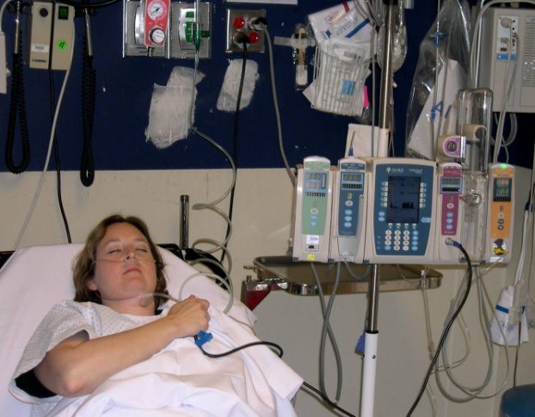
Why should Respiratory Care be involved in Pain Management?
RTs have keen clinical assessment skills
RTs understand EtCO2 and it’s limitations
RTs have the ability to use good clinical judgment and to guide the care of patients suffering from Respiratory Depression.

Slide 12
Development of a Functional EtCO2 Tool
Early on in the evaluation process a problem was identified, in that the staff noticed that the EtCO2 Monitor would alarm indicating High Respiratory Rate. The patient’s resp. rate would be 20 bpm however the device would read 40 bpm.
The solution was to achieved by working with the manufacture to decreased the EtCO2 threshold , so that only true breaths and not fluctuations in the respiratory pattern would be counted as breaths. This was done and the problem was resolved.

Slide 13

Development of an efficient EtCO2 tool
Another process development was the creation of a new EtCO2 cannula design.
In the PACU unit it was noted that the no breath alarm would be sounding, even with the patient seemingly breathing effectively.
The new cannula was designed to provide increased surface area for CO2 sampling and hence improved accuracy. This action resolve the clinical issues that occurred in the PACU.

Slide 14
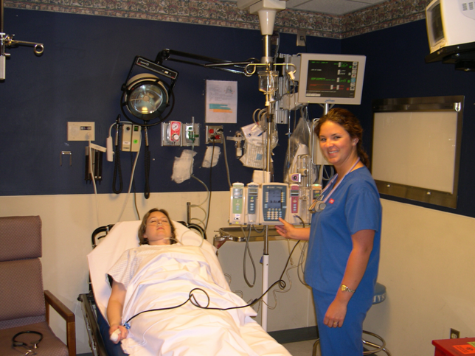
What do the RTs do?
Q shift monitoring of each patient on PCA therapy.
RTs assess patient’s history and adjust monitoring to meet patient’s status.
Reviews trended information (EtCO2, SpO2, Respiratory Rate, & PCA medication rates)
Provide bedside education regarding EtCO2 monitoring

Slide 15
Changes from Baseline –
Action Steps for Nursing Staff
Remember the ABC’s (airway, breathing, circulation)
Assess the patient
Follow your normal protocol, which may include:
  Stimulate patient if necessary
  Ensure open airway
  Check the cannula positioning
  Notify Respiratory Therapy
  Consider decreasing or stopping PCA and starting alternative drug delivery
  Inform M.D.
  Administer reversal agents as prescribed
Notes:
With any significant change, no matter what it is, your first action will always be the same: Assess your patient.
After assessing the patient, follow your hospital’s protocol, which may include
1. Ensure open airway
2. Provide gentle stimulation if the patient does not respond
3. Check the cannula and re-position for better sampling
Often, with prompt intervention, these simple actions will alleviate the problem.
In some cases, you may also need to:
• Stop drug delivery
Inform the physician and pause the procedure if necessary
Administer reversal agents as directed

Slide 16
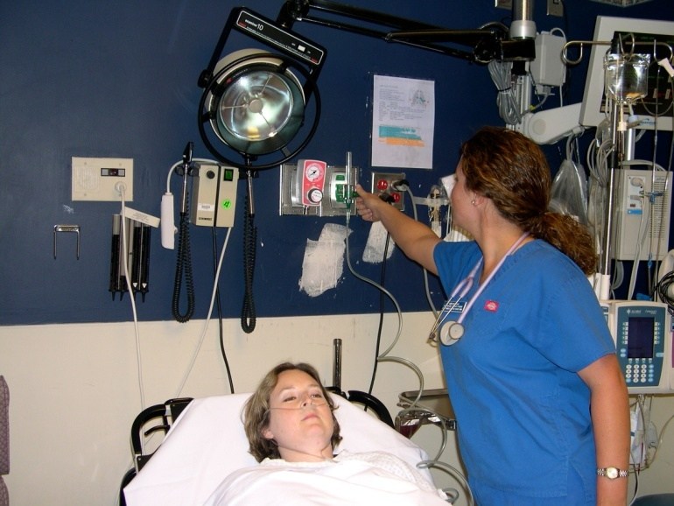
Typical Monitoring of Patients on PCA
Intermittent assessments of cognition, vital signs, pulse oximetry and pain scores.
Dangers of overmedication may not be detected.

Slide 17
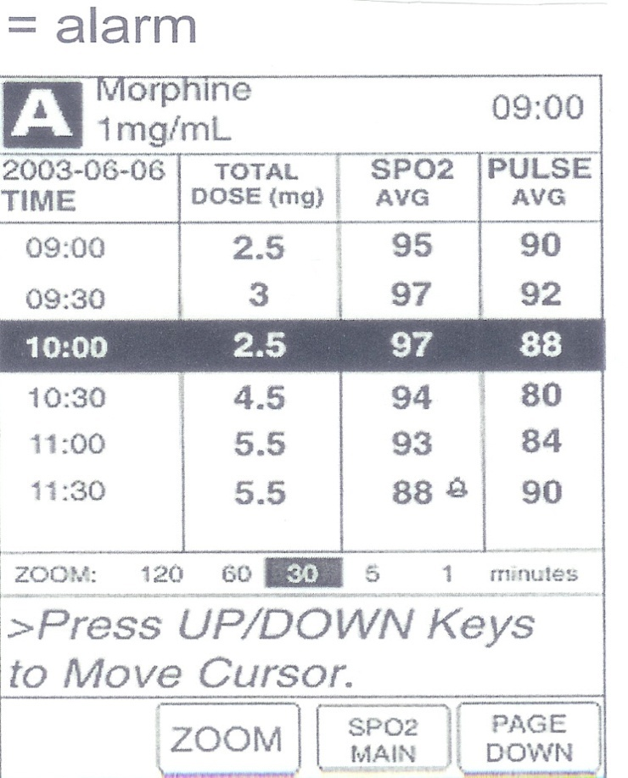
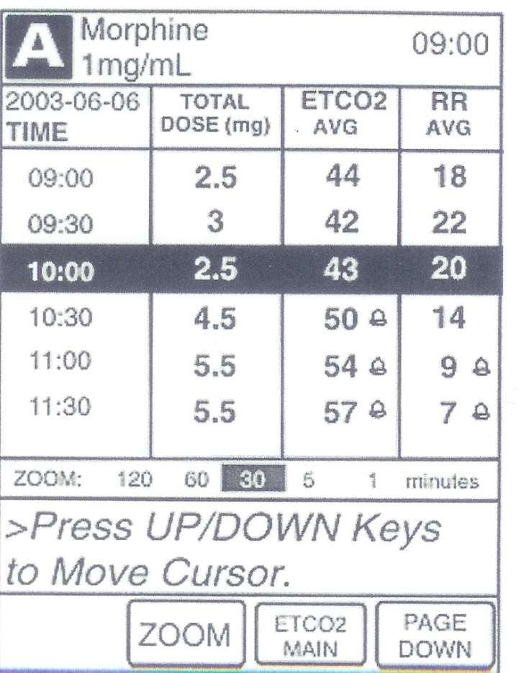
PCA Monitoring Trend Data:
Opioid Induced Respiratory Depression

Slide 18
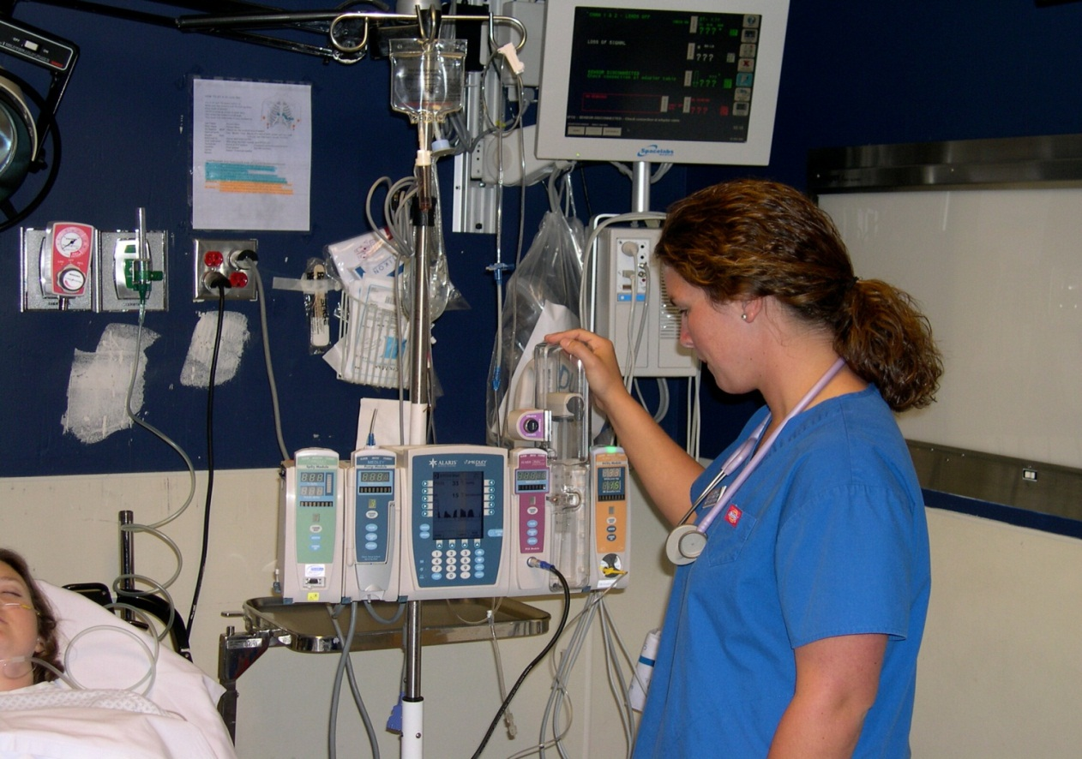
Change in the Culture of Care for Our PCA Patients

Slide 19
Improved Pain Management
Clinicians often times use extreme caution during narcotic administration.
Problem:
Under medication to prevent respiratory depression resulting in poor pain control.
Solution:
Add continuous monitoring to provide clinicians with assessment tools that assist in the detection of respiratory depression and allow adequate administration of analgesics.

Slide 20
Findings Using Continuous Etco2 and Spo2 Monitoring With PCA Therapy
Multiple “high risk” situations identified including:
Narcotic overdose leading to respiratory depression.
Apnea alarms.
Undiagnosed sleep apnea.
Post op pneumonia and Atelectasis.
Congestive heart failure.

Slide 21
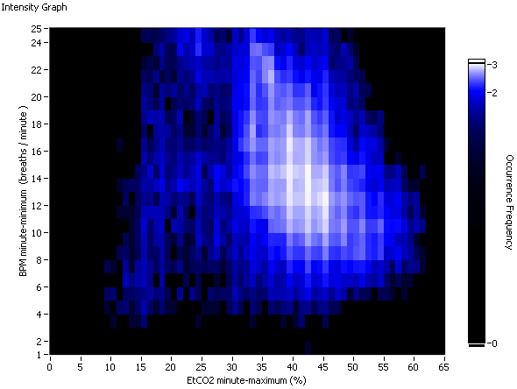
BPM low <8 7504
EtCO2 high >60 71
Both 9
Aggregated
50 patients SJC
low BPM versus high EtCO2
in same minute
1000
100
BPM minute-minimum ( per minute )
Occurrence Frequency
10
E_{t}CO2 minute-maximum(%)
BPM low Alarm if below

Slide 22
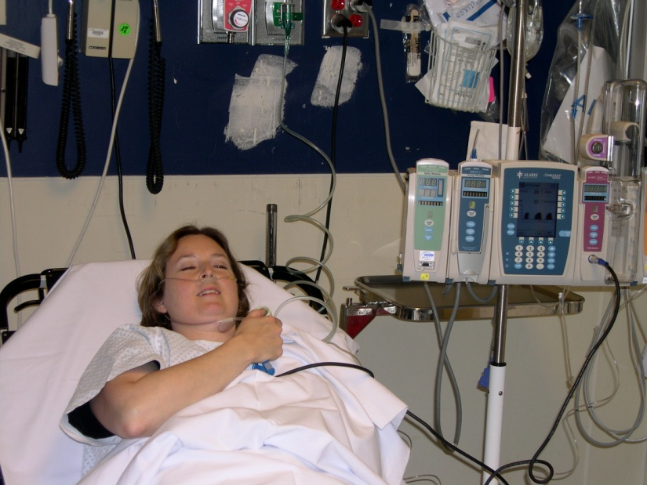
RESULT
Increased likelihood of better sustained pain control, faster recovery and discharge.
A better patient experience.
8 YEARS of event free usage of PCA therapy

Slide 23
SUMMARY OF OUR EXPERIENCE
EtCO2 provides earliest alert of decline in respiratory function.
Undiagnosed Sleep Apnea more prevalent than expected.
Post op respiratory depression unrelated to PCA detected.
Pain is more effectively controlled in patients with both high and low opioid tolerance.

Slide 24
CONCLUSION
Changes in respiratory status is a leading indicator of adverse patient response to opioid infusion or other types of clinical deterioration.
Current respiratory monitoring technology can aid in patient assessments and prevent serious adverse events.

Slide 25

THANK YOU

Slide 26
Panel Discussion
Moderator:
Gina Pugliese, RN MS vice president, Premier Safety Institute®
Michael Wong, JD executive director, Physician-Patient Alliance for Health & Safety
Harold J. A. Oglesby, RRT manager, The Center for Pulmonary Health Candler Hospital, Saint Joseph’s/ Candler Health System, Savannah, GA
Joan Speigel, MD assistant professor, Anesthesiology, Harvard Medical School and Beth Israel Deaconess Medical Ctr
Bhavani S. Kodali, MD associate professor, Department of Anesthesiology, Brigham and Women’s Hospital, Harvard Medical School

Slide 27





Thank you for joining us
Find additional resources on Premier Safety Institute® website
  Opioids and patient safety: www.premierinc.com/opioids
Please take a moment to answer the survey following the webinar.
Connect with Premier

