Slide 1

Advisor Live®
Safe opioid use – Strategies for reducing adverse events and related harm
March 4, 2014
@PremierHA
#AdvisorLive
Download today’s slides at www.premierinc.com/AdvisorLive

Slide 2
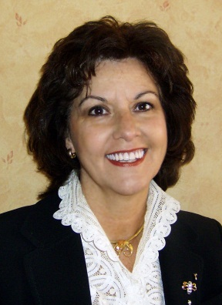




Faculty
Moderator:
Gina Pugliese, RN MS vice president, Premier Safety Institute®
Michael Wong, JD executive director, Physician-Patient Alliance for Health & Safety
Harold J. A. Oglesby, RRT manager, The Center for Pulmonary Health Candler Hospital, Saint Joseph’s/ Candler Health System, Savannah, GA
Joan Speigel, MD assistant professor, Anesthesiology, Harvard Medical School and Beth Israel Deaconess Medical Ctr
Bhavani S. Kodali, MD associate professor, Department of Anesthesiology, Brigham and Women’s Hospital, Harvard Medical School

Slide 3


First National
Patient-Controlled Analgesia Survey of Hospital Practices:
The Results
Michael Wong, JD
Founder/Executive Director
Physician-Patient Alliance for Health & Safety

Slide 4
Agenda
Impetus for the survey
Survey methodology & respondents
Statistical analysis
Result yardstick
Major conclusions:
  Inconsistent Consideration of Patient Risk Factors increases patients overall risks
  Inconsistent double checks puts patients at risk
  Reducing alarm fatigue may increase use of patient monitoring
  Continuous electronic monitoring reduces adverse events and hospital expenditures

Slide 5
Impetus for the Survey
More than 13 million patients
each year receive PCA in US
0.16 to 5.2%
suffer respiratory depression (est.)
Between 20,800 to 676,000 PCA patients
will experience opioid-induced respiratory depression
Robert Stoelting, MD
(President, Anesthesia Patient Safety Foundation) presentation, Patient, Safety Science & Technology Summit (January 2013)

Slide 6
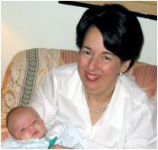





Impetus for the Survey
Louise Batz
unmonitored use of PCA after
knee replacement surgery
http://ppahs.org/2012/01/13/guest-post-monitoring-can-prevent-errors-with-patient-controlled-analgesia/
Robert Goode
unmonitored use of PCA after
hiatal hernia surgery
http://community.advanceweb.com/blogs/nurses3/archive/2013/07/03/nursing-spot-checks-for-patient-safety-a-nurse-s-perspective.aspx
Amanda Abbiehl
18-year old, admitted for “severe strep throat”
unmonitored use of PCA
http://promisetoamanda.org/?page_id=32
Justin Micalizzi
unmonitored PCA after
surgery to incise and drain a swollen ankle
http://ppahs.org/2011/08/18/would-monitoring-have-saved-justin-micalizzi/
Leah Coufal
unmonitored epidural anesthesia after
surgery for pectus carinatum
http://ppahs.org/2012/02/01/guest-post-yes-real-time-monitoring-would-have-saved-leah-2/
Tyler Ireland
unmonitored PCA after
surgery for collapsed lung

Slide 7
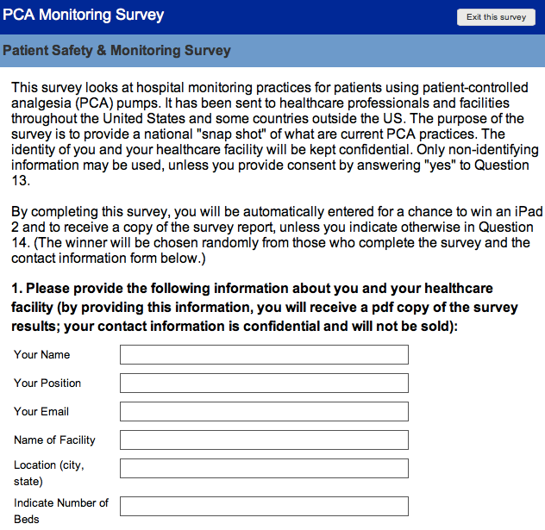
Survey Methodology & Respondents
Online survey developed & sent out
Survey developed with input from:
Corey Angst, PhD, MBA (Asst Prof, Dept of Mgmt, Mendoza College of Business, U of Notre Dame)
Richard Dutton, MD, MBA (Exec Director, Anesthesia Quality Institute)
Frank Federico, RPh (Exec Director, IHI, and Patient Safety Advisory Group of TJC)
Matthew Grissinger (Dir, Error Reporting , ISMP)
Stephen Howell, MSN (Lead Nurse Practitioner, University of Alabama School of Medicine)
Ken Kelley, PhD, MA (Viola D. Hank Assoc Prof of Mgmt, Mendoza Coll of Business, U of Notre Dame)
Joe Kiani, MSEE (CEO, Masimo)
Carter King, MBA (VP, Business Operations, AcelRx)
Mary Lynn McPherson (Professor, University of MD School of Pharmacy)
John Tucker, MBA (Chief Commercial Officer, Incline Therapeutics)
Rodney Tucker, MD, MMM (Assoc Prof, U of AL)
Greg Spratt, RRT, CPFT (Dir of Clinical Marketing, Covidien)
Tim Vanderveen, PharmD, MS (VP, Center for Safety and Clinical Excellence, CareFusion)
E mail link provided to:
hospital pharmacists
IHI hospital networks
Premier members

Slide 8
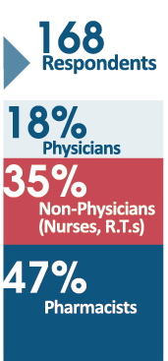
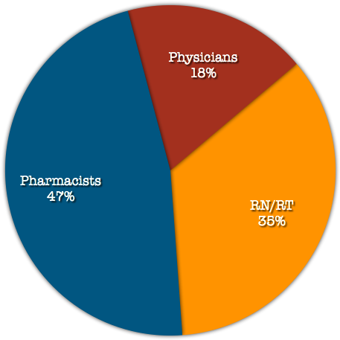
Survey Methodology & Respondents
Profession of Respondents

Slide 9
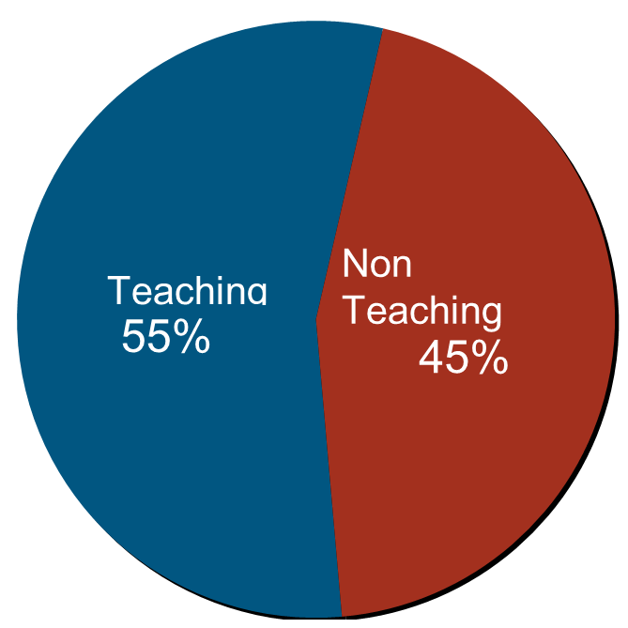
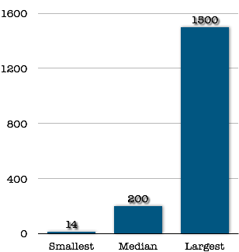
Survey Methodology & Respondents
Results from Hospitals in 40 States
Hospital
(no. of beds)
Teaching vs. Non-Teaching
+

Slide 10
Statistical Analysis
Anuj Mabuyi, PhD
Assistant Professor Department of Mathematics
Northeastern Illinois University
Beverly Gonzalez, ScM
Biostatistician
Johns Hopkins Bloomberg School of Public Health

Slide 11
Result Yardstick
Anesthesia Patient Safety Foundation
“Conclusions and Recommendations-Conference on Electronic Monitoring Strategies”
Association for the Advancement of Medical Instrumentation
“Infusing Patients Safely: Priority Issues From AAMI/FDA Infusion Device Summit” (2010)
Institute for Safe Medication Practices
“Safety issues with patient-controlled analgesia Part I - How errors occur” ISMP Med Saf Alert, 2003 Jul 10; 8(14):1
“Part II - How to Prevent Errors - Safety Issues with Patient-Controlled Analgesia (July 24, 2003)
The Joint Commission
“Safe use of opioids in hospitals”
Sentinel Event Alert, Issue 49, August 8, 2012
National Comprehensive Cancer Network
Adult Cancer Pain Guidelines (2010)
Pennsylvania Patient Safety Authority
“Making Patient-Controlled Analgesia Safer for Patients”
Vol. 8, No. 3 (September 2011)
Numerous Peer-Reviewed Research and Studies

Slide 12
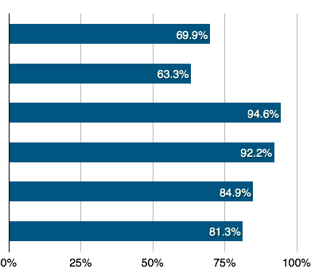
Risk Factors Inconsistently Considered Puts Patients At Risk
Tremendous variation in treatment received by patients across the country:
About 2 out of 3 hospitals not considering all six major patient risk factors
More than 60 percent of respondents are considering five or less factors
Less than 40 percent are considering all six patient risk factors
Six major patient risk factors listed by healthcare organizations like The Joint Commission
and ISMP
What patient risk factors do you consider for patients initially going on PCA
(please check all that apply)
Obesity
Low body weight
Concomitant medications that potentiate
sedative effects of opiate PCA
Pre-existing conditions (such as asthma,
COPD, sleep apnea)
Advanced Age
Opioid Naive

Slide 13

Risk Factors Inconsistently Considered Puts Patients At Risk:
Opioid Naive
Recommendation
Practice
The Joint Commission:
take “extra precautions with patients who are new to opioids or who are being restarted on opioids”
[Sentinel Event Alert, Issue 49, August 8, 2012]
Almost 1 out of 5 hospitals are not assessing patients for being opioid naive:
Pharmacists 4x more likely to consider
Physicians approximately 70% less likely to consider
Likelihood by Profession to Consider Whether Patient is Opioid Naive Before Initiating PCA
More Likely
Pharmacists
(OR=4.072; 95% CI 1.590-10.428)
x
x
x
x
Nurses, RTs
Less Likely
0.3x
Physicians
(OR=0.324; 95% CI 0.133-0.787)

Slide 14
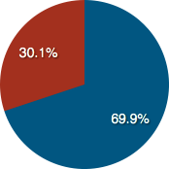
Risk Factors Inconsistently Considered Puts Patients At Risk:
Obese Patients
Recommendation
Practice
Three out of every 10 hospitals do not consider obesity as a patient risk factor
Many studies have shown the increased risk of using anesthesia with obese patients
[J. Ingrande and H. J. M. Lemmens, “Dose adjustment of anaesthetics in the morbidly obese” British of Journal of Anesthesia Volume 105, Issue suppl 1]
Obesity Considered a Risk Factor Prior to Initiating PCA
Do Not Consider Obesity a Risk Factor
Consider Obesity a Risk Factor

Slide 15
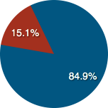
Risk Factors Inconsistently Considered Puts Patients At Risk:
Advanced Age
Recommendation
Practice
About three out of every 20 hospitals do not consider advanced age as a patient risk factor
The Joint Commission cautions against the use of opioids in older patients because of the heightened risk of oversedation and respiratory depression
[The Joint Commission, Sentinel Event Alert, Issue 49, August 8, 2012]:
2.8 times higher for individuals aged 61-70
5.4 times higher for age 71-80
8.7 times higher for those over age 80
Advanced Age Considered a Risk Factor Prior to Initiating PCA
Do Not Consider Advanced Age a Risk Factor
Consider Advanced Age a Risk Factor

Slide 16
Double Checks Inconsistently Performed Puts Patients At Risk
Patient’s identification —
Is the correct patient receiving the opioid?
Patient allergies —
Is the patient allergic to the medication?
Drug selection and concentration —
Is the patient receiving the prescribed medication and dosage?
Dose adjustments —
Has any dose adjustment been completed?
PCA pump settings —
Has the pump been programmed correctly?
Line attachment —
Has the pump been attached correctly to the patient?
Approximately 70% of PCA adverse events are due to errors associated with pump use
(e.g., misprogrammed doses and concentrations, installation of the wrong drug or concentration)
[Pennsylvania Patient Safety Authority, “Making Patient-Controlled Analgesia Safer for Patients” Vol. 8, No. 3 (September 2011)]

Slide 17
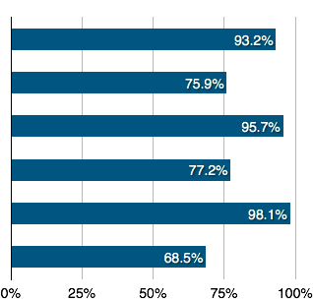
Double Checks Inconsistently Performed Puts Patients At Risk
There is great variation on what double-checks are made
Before PCA pump initiation, refilling or programming change, two healthcare providers double-check (please check all that apply)
Patient’s identification
Patient allergies appear on medication
administration record
Drug selection and concentration confirmed
as that which has been prescribed
Any necessary dose adjustments completed
PCA pump settings
Line attachment to patient and tubing
insertion into pump

Slide 18
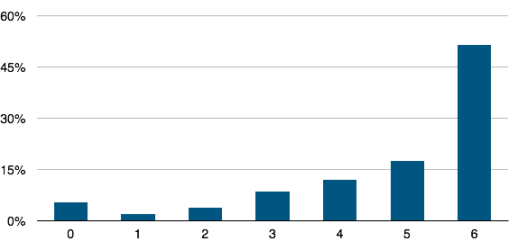
Double Checks Inconsistently Performed Puts Patients At Risk
Only slightly more than 1 out of every 2 hospitals (51.19%) performed all six double-checks
1 out of ten hospitals performed one or less double checks (10.71%)
Number of Double-Checks Performed

Slide 19
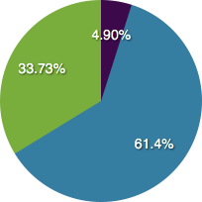
Reducing Alarm Fatigue Would Increase Use of Patient Monitoring:
Concern About Alarm Fatigue
More than 19 in 20 hospitals (95.1%) say
they are concerned about alarm fatigue
How would you rate your concern about potential alarm fatigue about continuous electronic monitoring?
Not concerned at all
Concerned that it will be a problem that is difficult to manage or is preventing us from implementing
Concerned but don’t believe it will be an unmanageable problem

Slide 20
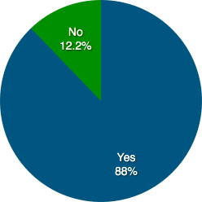
Reducing Alarm Fatigue Would Increase Use of Patient Monitoring
If No Alarm Fatigue, More Hospitals Would Monitor
Almost one in ten hospitals (87.8 percent) believe that a reduction of false alarms would increase the use of patient monitoring devices, like an oximeter or capnograph.
Do you believe that reduction of false alarms
would increase the use of patient
monitoring devices, like an oximeter or capnograph?

Slide 21
Reducing Alarm Fatigue Would Increase Use of Patient Monitoring: Tools and Training Hospitals Want
Ease of Assessment: Need for Single Indicator
Seven out of 10 hospitals (70.7%) would like “a single indicator that accurately incorporates key vital signs, such as pulse rate, SpO2, respiratory rate, and etCO2.”
Those concerned alarm fatigue is an unmanageable problem:
more than twice as likely to want a single-indicator assessment tool (OR=2.278; 95% CI 1.073-4.838)
recommendations for ease of assessment for their nursing staff (OR=2.039; 95% CI 0.992-4.190).

Slide 22
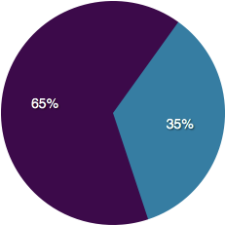
Continuous Electronic Monitoring Reduces Adverse Events & Hospital Expenditures
Continuous Electronic Monitoring Reduces Adverse Events, Costs, and Expenses
Of those hospitals that monitor some or all patients with pulse oximetry or capnography:
  65 percent have experienced positive results -- either in terms of a reduction of overall adverse events or costs and expenses
  35% say it is “too early to determine or have not determined.”
Those using smart pumps with integrated end tidal monitoring were almost three times more likely to have had a reduction in adverse events or a return on investment in terms of a reduction in costs and expenses (OR=2.789; 95% CI 1.112-6.996).
Continuous Electronic Monitoring Reduces Adverse Events, Costs, and Expenses
Monitor and experienced positive results -- either in terms of a reduction of overall adverse events or have had a return on investment when measured against costs and expenses (including litigation costs)
Monitor, but too early to determine or have not determined

Slide 23
Continuous Electronic Monitoring Reduces Adverse Events & Hospital Expenditures
Continuous Electronic Monitoring Will Become Standard Procedure
Of the hospitals that are not electronically monitoring any of their patients, almost nine out of 10 (86.7 percent) say they are considering the use of monitoring.

