Slide 1


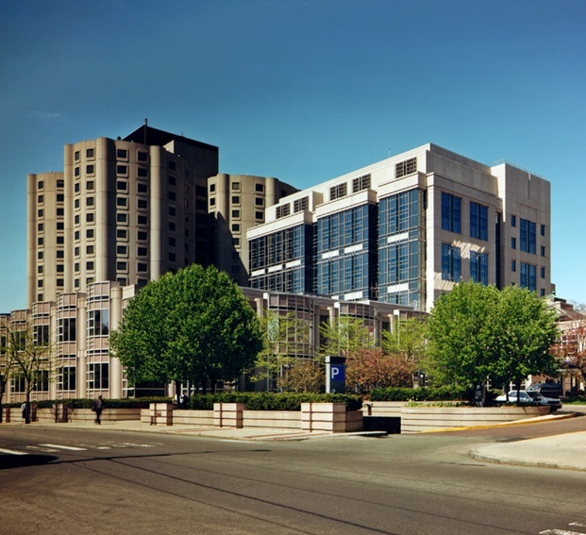
Capnography
How to get most from it?
Bhavani Shankar Kodali, MD
Vice Chairman
Brigham and Women’s Hospital,
Associate Professor
Harvard Medical School
Bhavani Shankar Kodali MD

Slide 2
www.capnography.org www.capnography.com www.capnography.us www.capnography.net www.capnography.biz
Bhavani Shankar Kodali MD

Slide 3
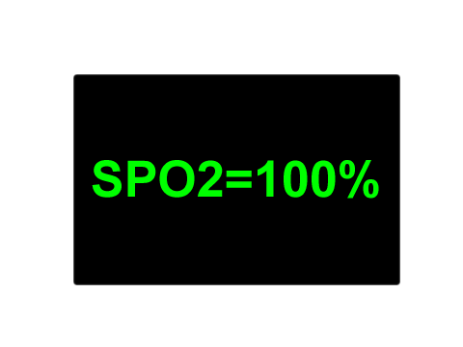
Pulse oximeter is an excellent monitor of hypoxia but may not identify the etiology
Bhavani Shankar Kodali MD

Slide 4

Capnography can identify situations that can potentially result in hypoxia
Capnography helps to assess anesthesia equipment, circuits, ventilation perfusion mismatching in the lungs, cardiac output, and metabolism
Bhavani Shankar Kodali MD

Slide 5
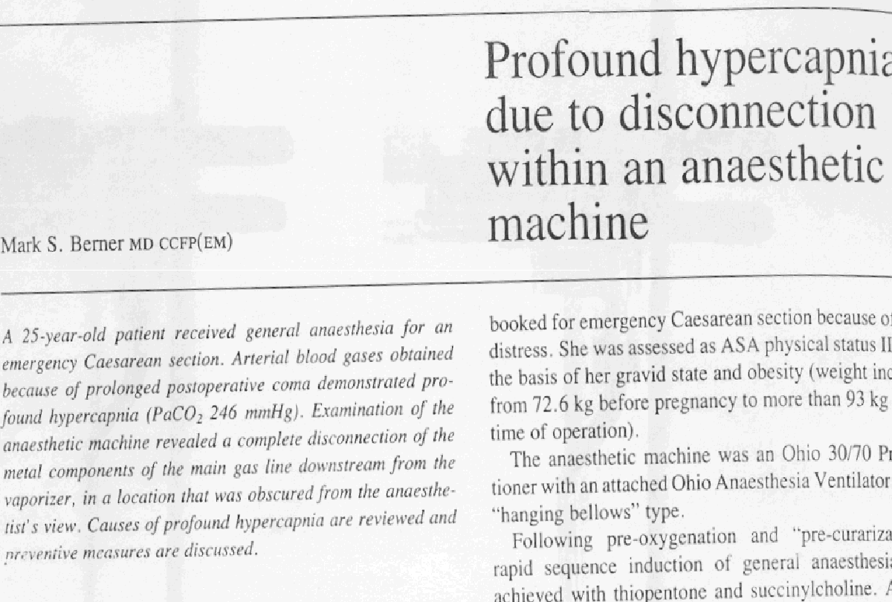
Capnography could have identified the problems that were reported before the era of Capnography
Bhavani Shankar Kodali MD

Slide 6
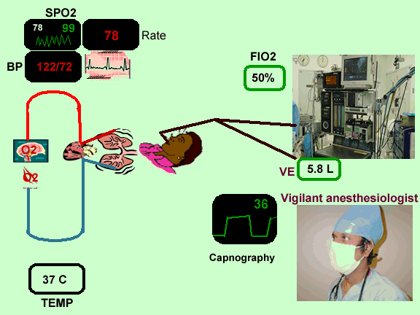
Bhavani Shankar Kodali MD

Slide 7
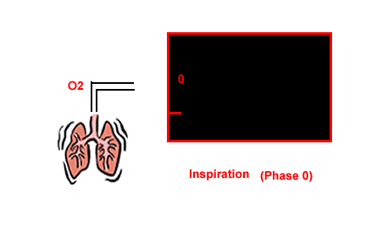
Bhavani Shankar Kodali MD

Slide 8

Bhavani Shankar Kodali MD

Slide 9
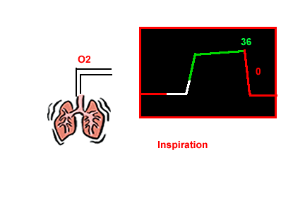
Bhavani Shankar Kodali MD

Slide 10
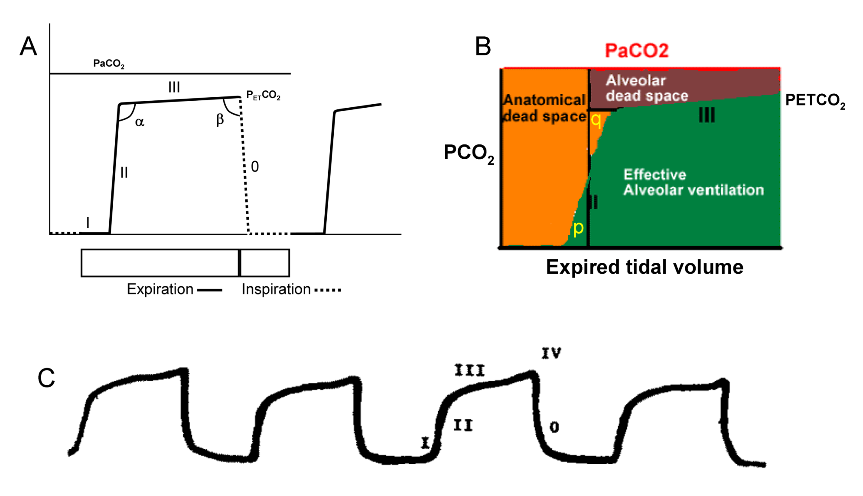
Bhavani Shankar Kodali MD

Slide 11

Terminology
Bhavani Shankar Kodali MD

Slide 12
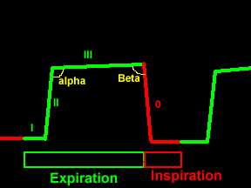
Bhavani Shankar Kodali MD

Slide 13
www.capnography.com
Bhavani Shankar Kodali MD

Slide 14
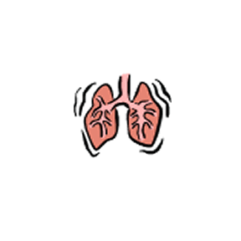
Ventilation
Bhavani Shankar Kodali MD

Slide 15
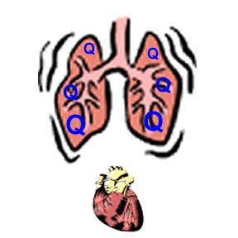
Perfusion
Bhavani Shankar Kodali MD

Slide 16
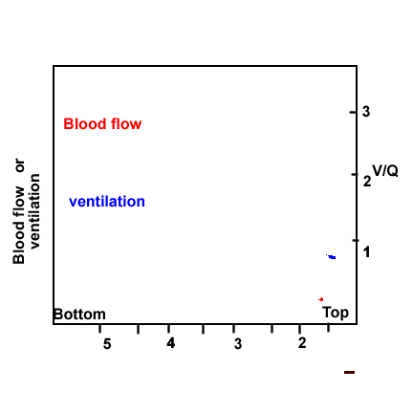
Bhavani Shankar Kodali MD

Slide 17
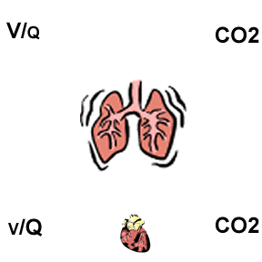
Spectrum of V/Q
Bhavani Shankar Kodali MD

Slide 18
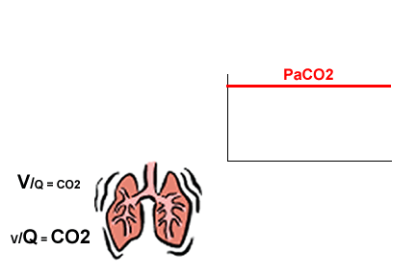
Bhavani Shankar Kodali MD

Slide 19

Bhavani Shankar Kodali MD

Slide 20
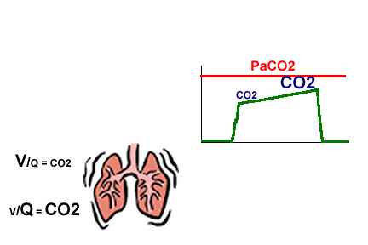
Bhavani Shankar Kodali MD

Slide 21
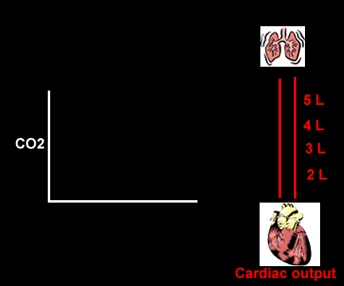
How does cardiac output affect PETCO₂?
Bhavani Shankar Kodali MD

Slide 22

Bhavani Shankar Kodali MD

Slide 23

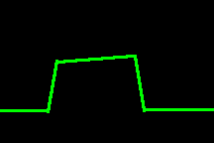
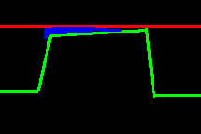
Clinical applications
From Numbers- PETCO₂ values- Capnometry
From Lines and Curves--Shapes of capnograms - Capnography
From (a-ET)PCO₂ gradients or differences- Alveolar dead space
www.capnography.com
Bhavani Shankar Kodali MD

Slide 24
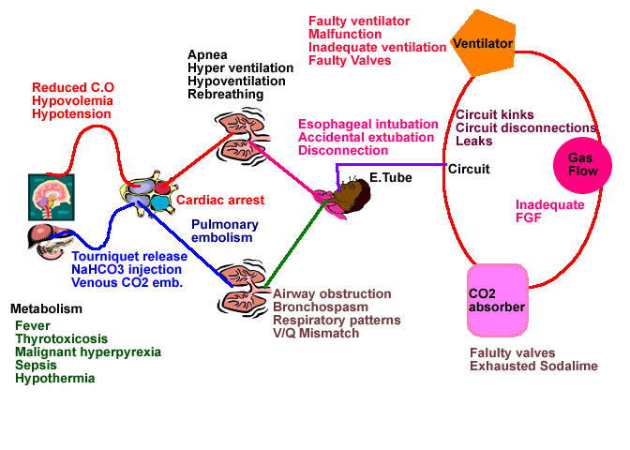
Faulty valves
Exhausted Sodalime
Bhavani Shankar Kodali MD

Slide 25
Airway Integrity
Bhavani Shankar Kodali MD

Slide 26
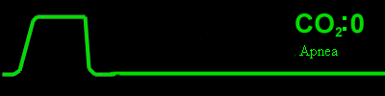
Apnea Monitor
www.capnography.com
Bhavani Shankar Kodali MD

Slide 27

Confirmation of Intubation
Misplaced Endo-tracheal tube
Bhavani Shankar Kodali MD
www.capnography.com

Slide 28
Normal vs.
Bronchospasm/COPD
Bhavani Shankar Kodali MD
www.capnography.com

Slide 29
Ventilation
Bhavani Shankar Kodali MD

Slide 30
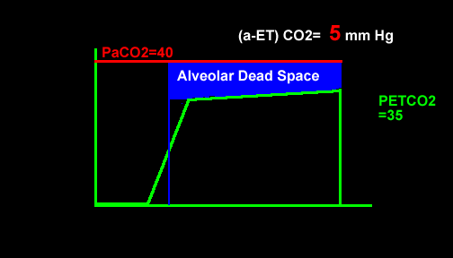
Noninvasive Monitor of Ventilation
Bhavani Shankar Kodali MD

Slide 31
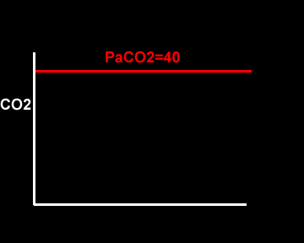
Noninvasive Monitor of Ventilation
Bhavani Shankar Kodali MD

Slide 32

Hypoventilation
Bhavani Shankar Kodali MD
www.capnography.com

Slide 33
Hyperventilation
Bhavani Shankar Kodali MD
www.capnography.com

Slide 34
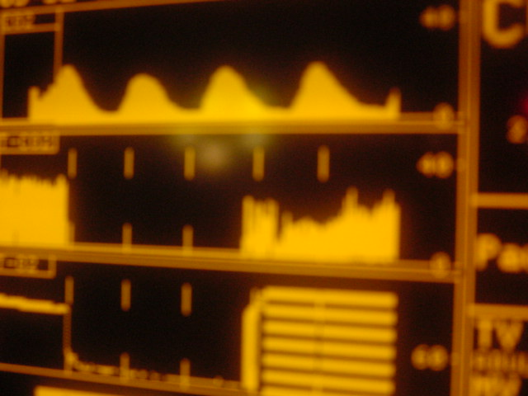
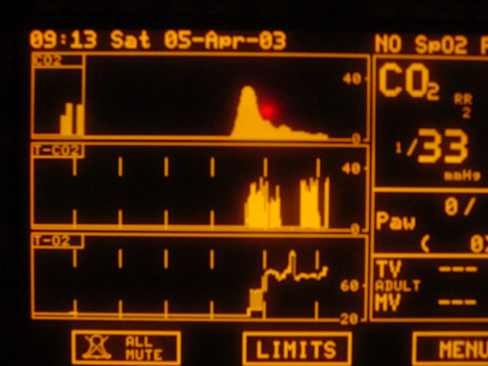
Over Sedation
www.capnography.com
Bhavani Shankar Kodali MD

Slide 35
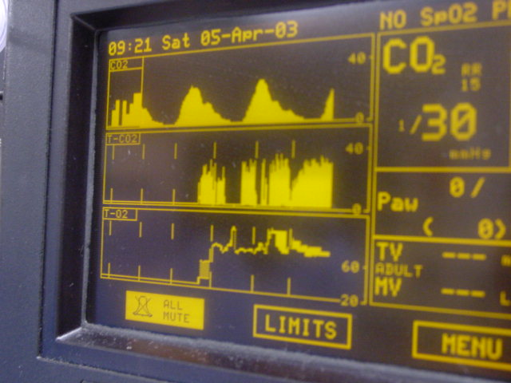
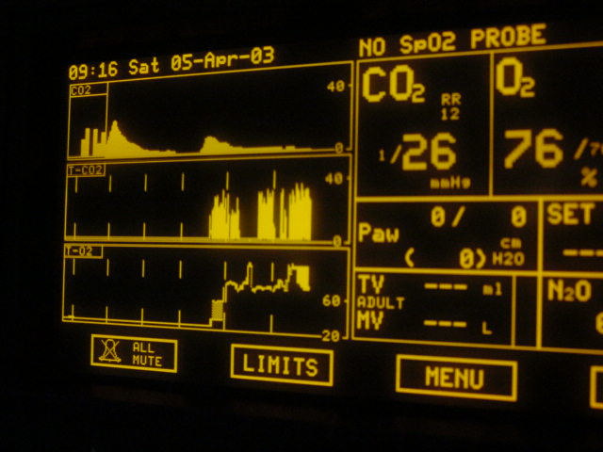
Over Sedation
www.capnography.com
Bhavani Shankar Kodali MD

Slide 36
How does cardiac output affect PETCO₂?
www.capnography.com
Bhavani Shankar Kodali MD

Slide 37
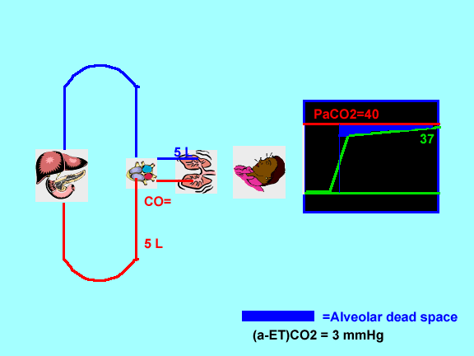
Decreased cardiac output
Bhavani Shankar Kodali MD
www.capnography.com

Slide 38
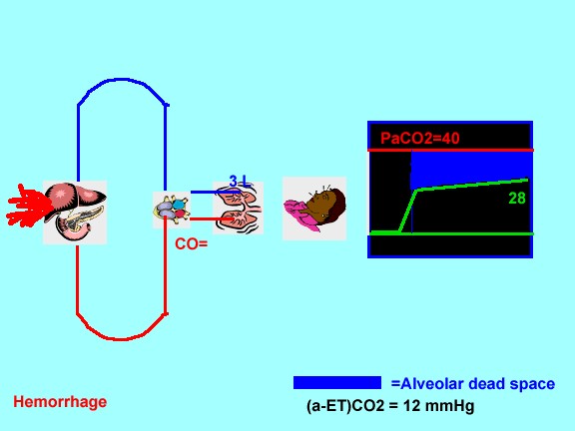
Decreased cardiac output
Bhavani Shankar Kodali MD

Slide 39
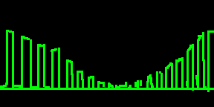
Cardiac arrest and successful resuscitation
Bhavani Shankar Kodali MD
www.capnography.com

Slide 40
If ETCO₂ is normal and BP is normal
Bhavani Shankar Kodali MD

Slide 41

If ETCO₂ is normal and BP is low
Bhavani Shankar Kodali MD

Slide 42
If ETCO₂ is normal and BP is low
Bhavani Shankar Kodali MD

Slide 43

If ETCO₂ is normal and BP is low
Bhavani Shankar Kodali MD

Slide 44
If ETCO₂ is low and BP is low
Bhavani Shankar Kodali MD

Slide 45

If ETCO₂ is low and BP is low
Bhavani Shankar Kodali MD

Slide 46
BP- Very low, but ETCO₂ are reasonable
Bhavani Shankar Kodali MD

Slide 47
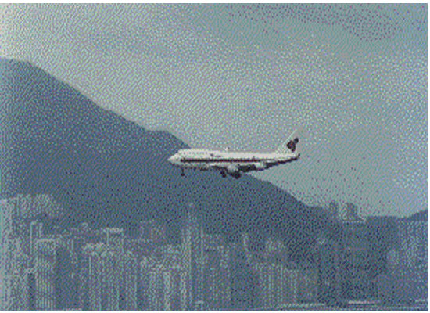
BP- Very low, but ETCO₂ are reasonable
Bhavani Shankar Kodali MD

Slide 48
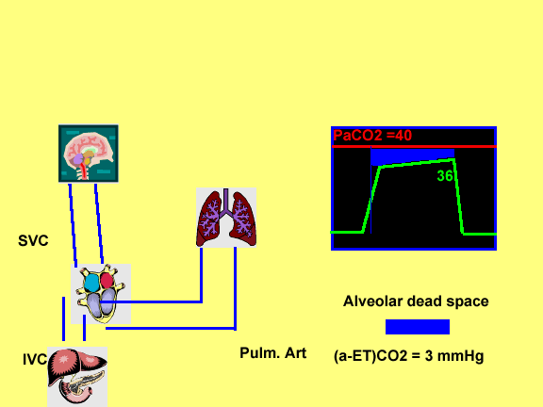
Air embolism
Bhavani Shankar Kodali MD
www.capnography.com

Slide 49
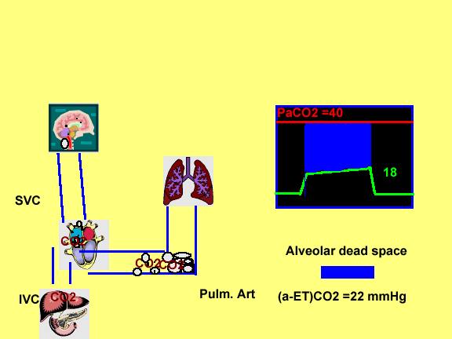
Air embolism
Bhavani Shankar Kodali MD

Slide 50
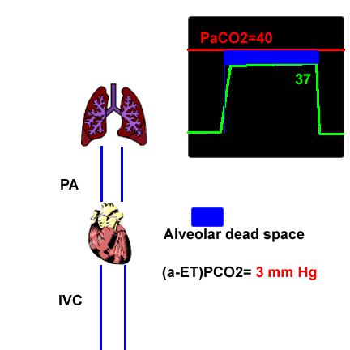
Thromboembolism
Bhavani Shankar Kodali MD
www.capnography.com

Slide 51
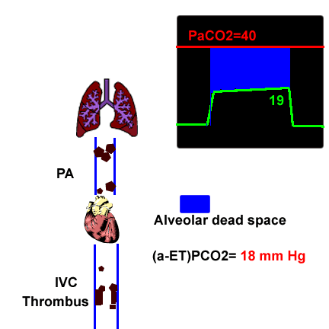
Thromboembolism
Bhavani Shankar Kodali MD

Slide 52

IMV breathing
Bhavani Shankar Kodali MD
www.capnography.com

Slide 53
Pediatric capnograms
Bhavani Shankar Kodali MD
www.capnography.com

Slide 54
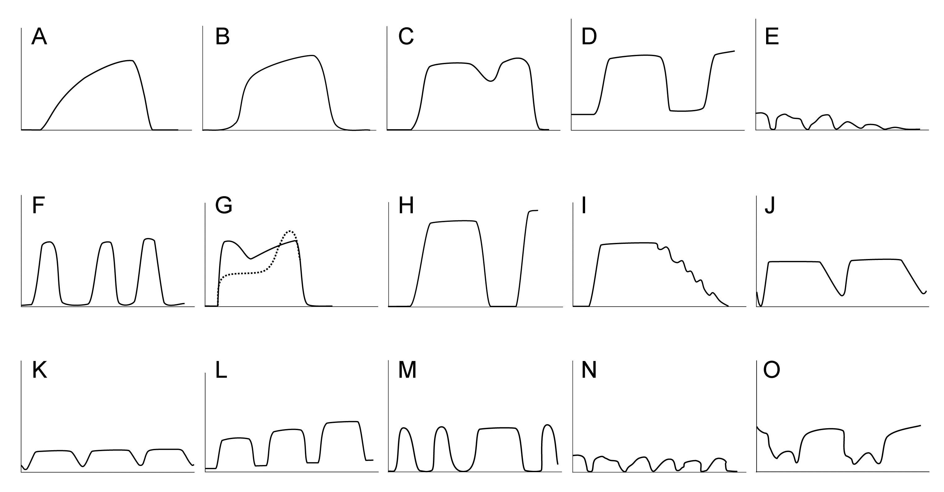
Bhavani Shankar Kodali MD

Slide 55
Aortic Surgery
A decrease of ETCO2 > 15%
Decrease in SBP > 20%
Bhavani Shankar Kodali MD

Slide 56
Laparoscopy
It is mandatory
Embolism
Ventilatory adjustments
Diagnose complications
Bhavani Shankar Kodali MD

Slide 57
Thoracic Anesthesia
Bhavani Shankar Kodali MD

Slide 58
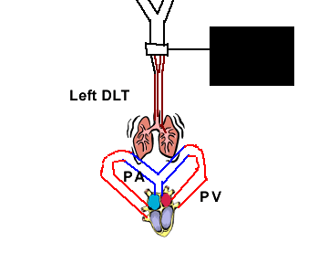
Bhavani Shankar Kodali MD

Slide 59

Bhavani Shankar Kodali MD

Slide 60
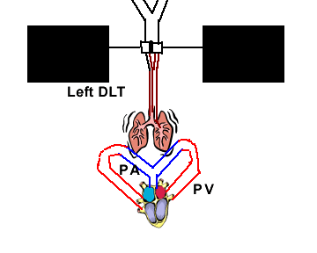
Bhavani Shankar Kodali MD

Slide 61

Bhavani Shankar Kodali MD

Slide 62
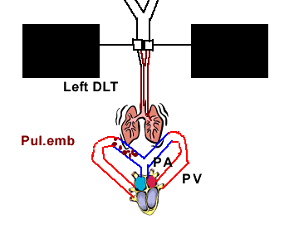
Bhavani Shankar Kodali MD

Slide 63

Bhavani Shankar Kodali MD

Slide 64
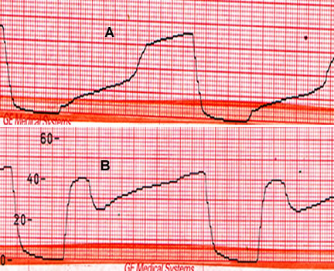
Lung Transplant
Bhavani Shankar Kodali MD
www.capnography.com

Slide 65
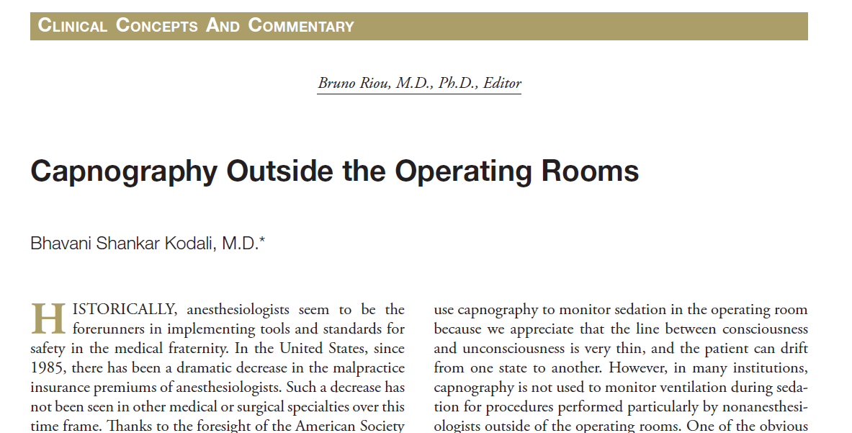
Capnography Outside the Operating Rooms
Bhavani Shankar Kodali MD

Slide 66
Capnography Outside the Operating Rooms
Sedation in all areas
CPR
Intensive Care Units
Postoperative patients receiving narcotics
Prehospital transport
Interdepartmental transport
Bhavani Shankar Kodali MD

Slide 67
Where are we heading?
Angiography
Endoscopy
Cath Labs
Capnography Operating Rooms
ED
Transportation
PACU
Postoperative
ICU
NICU
Bhavani Shankar Kodali MD

Slide 68
New Standards of Monitoring
American Society of Anesthesiologists (ASA) and the Association of Anaesthestists of Great Britain and Ireland (AAGBI) have revised standards in 2011 to monitor ventilation with capnography for all procedural sedation cases requiring moderate to deep sedation.
Bhavani Shankar Kodali M.D.
www.capnography.com
Bhavani Shankar Kodali MD

Slide 69
Why were they introduced?
It is difficult to predict how an individual will respond to an administered sedative.
Incidence of hypoxia is less if capnography was used to monitor ventilation.
Capnography, when used in conjunction with pulse oximetry and visual inspection of chest, detected respiratory depression 17 times more often than without capnography.
Capnography forewarns of impending hypoxia by about 5 to 240 seconds.
Capnography triggers early intervention and decreases the incidence of oxygen desaturation.
Administration of supplemental oxygen delays the onset of desaturation following apnea, and, therefore, relying on pulse oximetry alone will delay intervention.
Bhavani Shankar Kodali M.D.
www.capnography.com
Bhavani Shankar Kodali MD

Slide 70
CPR
American Heart Association (AHA) recommends the use of capnography not only for confirmation of tracheal tube placement but also to monitor the effectiveness of chest compressions during CPR.
Bhavani Shankar Kodali MD

Slide 71
CO₂ waveform during CPR
Optimize chest compression
for effective CPR
so that PETCO₂ values are between 10 and 20 mm Hg (>20 mm Hg).
If PETCO₂ values, measured after initiation of ACLS, are less than 10 mm Hg, it is associated with a poor outcome.
Bhavani Shankar Kodali MD

Slide 72
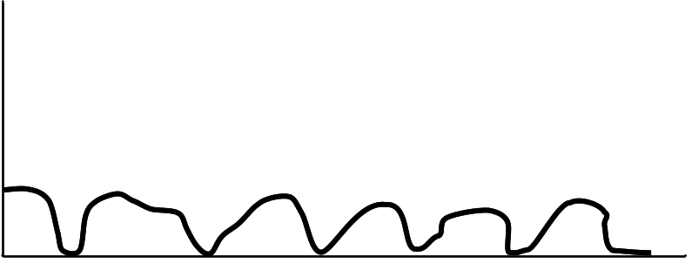
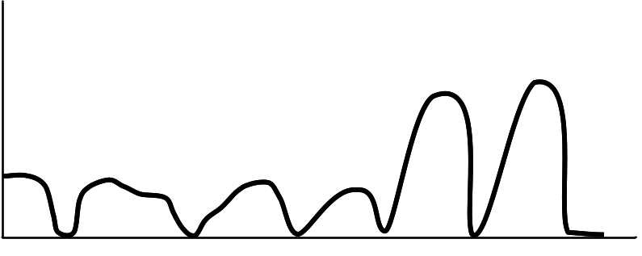
CO₂ waveform during CPR
A
B
An abrupt increase in PETCO₂ may indicate a return of spontaneous circulation(ROSC). Increase in pulmonary circulation brings more CO₂ into lungs for elimination.
Bhavani Shankar Kodali MD

Slide 73
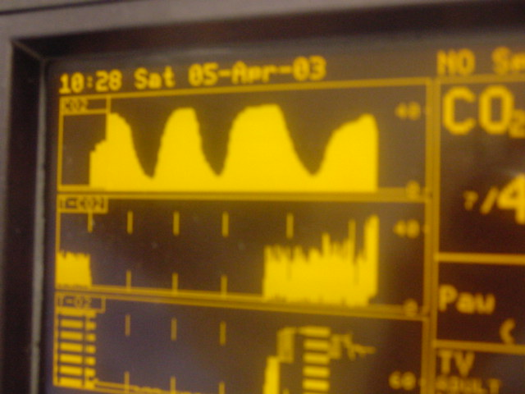
Capnograms during spontaneous ventilation
The shape of the capnograms obtained when oxygen is being administered via face mask can be different due to dilution of expired CO₂ by oxygen or room air as shown below.
Bhavani Shankar Kodali M.D.
www.capnography.com
Bhavani Shankar Kodali MD

Slide 74

National Audit Project (NAP4)
Royal College of Anaesthetists and Difficult Airway Society
(BJA 2011;106(5):613,617,632)
Major complications of airway management in three places: OT/OR, ED, ICU
Anesthesia -- 16 airway related deaths in 3 million anesthetics monitored with capnography (1 in 180000)
ICU-- 18 airway related deaths in 48000 receiving ventilation (1 in 2700). 74% of the incidents were considered preventable with continuous capnography
Bhavani Shankar Kodali MD

Slide 75
National Audit Project (NAP4)
Royal College of Anaesthetists and Difficult Airway Society (BJA 2011;106(5):613,617,632
The risk of encountering major airway complications in ICU is about 66 times more often than in OT/OR because continuous capnography is not used.
25% to 100%
Bhavani Shankar Kodali MD

Slide 76
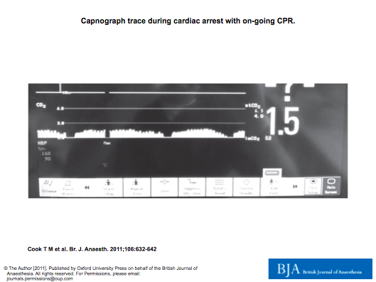
Bhavani Shankar Kodali MD

Slide 77
NAP4
Capnography should be use in all patients for intubation irrespective of location.
Routine use of continuous capnography in all patients intubated or with tracheostomy
If not used, state clinical reason
Train all staff in identification of abnormal waveforms
Checklist of intubation and tracheostomy - preparation, equipment, drugs and team
Bhavani Shankar Kodali MD

Slide 78
NAP4
Capnography should be use in all patients for intubation irrespective of location
Routine use of continuous capnography in all patients intubated or with tracheostomy
If not used, state clinical reason
Training all staff identification of abnormal waveforms
Checklist of intubation and tracheostomy - preparation, equipment, drugs and team
AAGBI
ICS
-During the procedures of tracheostomy
and intubation
-Inter and intra hospital transfers
-Short for recommending for continuous
use and asking for more evidence
Bhavani Shankar Kodali MD

Slide 79
ICU – Overall benefit to be taken into account
Expertise in ICUs is variable
ICU patients have less margin of safety
Undiagnosed inadvertent ET displacement in ICU patients accounted for substantial number of deaths
AHA recommends using capnography during CPR
Use of capnogram shapes to diagnose conditions
Use of arterial to end-tidal PCO₂ difference as a surrogate of PaCO₂
Diagnosing inadvertent placement of NG tubes
Assisting percutaneous tracheostomies
Capnography as a guide to metabolic rate
Capnography to confirm apnea in brain death
Decreasing high cost associated with multiple ABG’s
Volumetric capnography to assess progressive changes in dead space
Bhavani Shankar Kodali MD

